Slide 1
lxD Comparison of Technomarket and Technopolis
by Yavor Aldev

Slide 2
Content
1 – Menu
2 – Filter & Sorting
3 – Compare products
4 – Add/delete from shopping cart
5 - Checkout

Slide 3


What is Technomarket / Technopolis?
Technopolis and Technomarket are Bulgarian tech stores that both sell various tech (TVs, game consoles, laptops, phones, etc.) as well as “white tech” (ovens, washing machines, coffee makers, etc.)
They’re the two biggest tech stores in Bulgaria, and while the items they sell are similar, their online stores look quite different. I’ll be comparing the two and give a summary in the end.

Slide 4
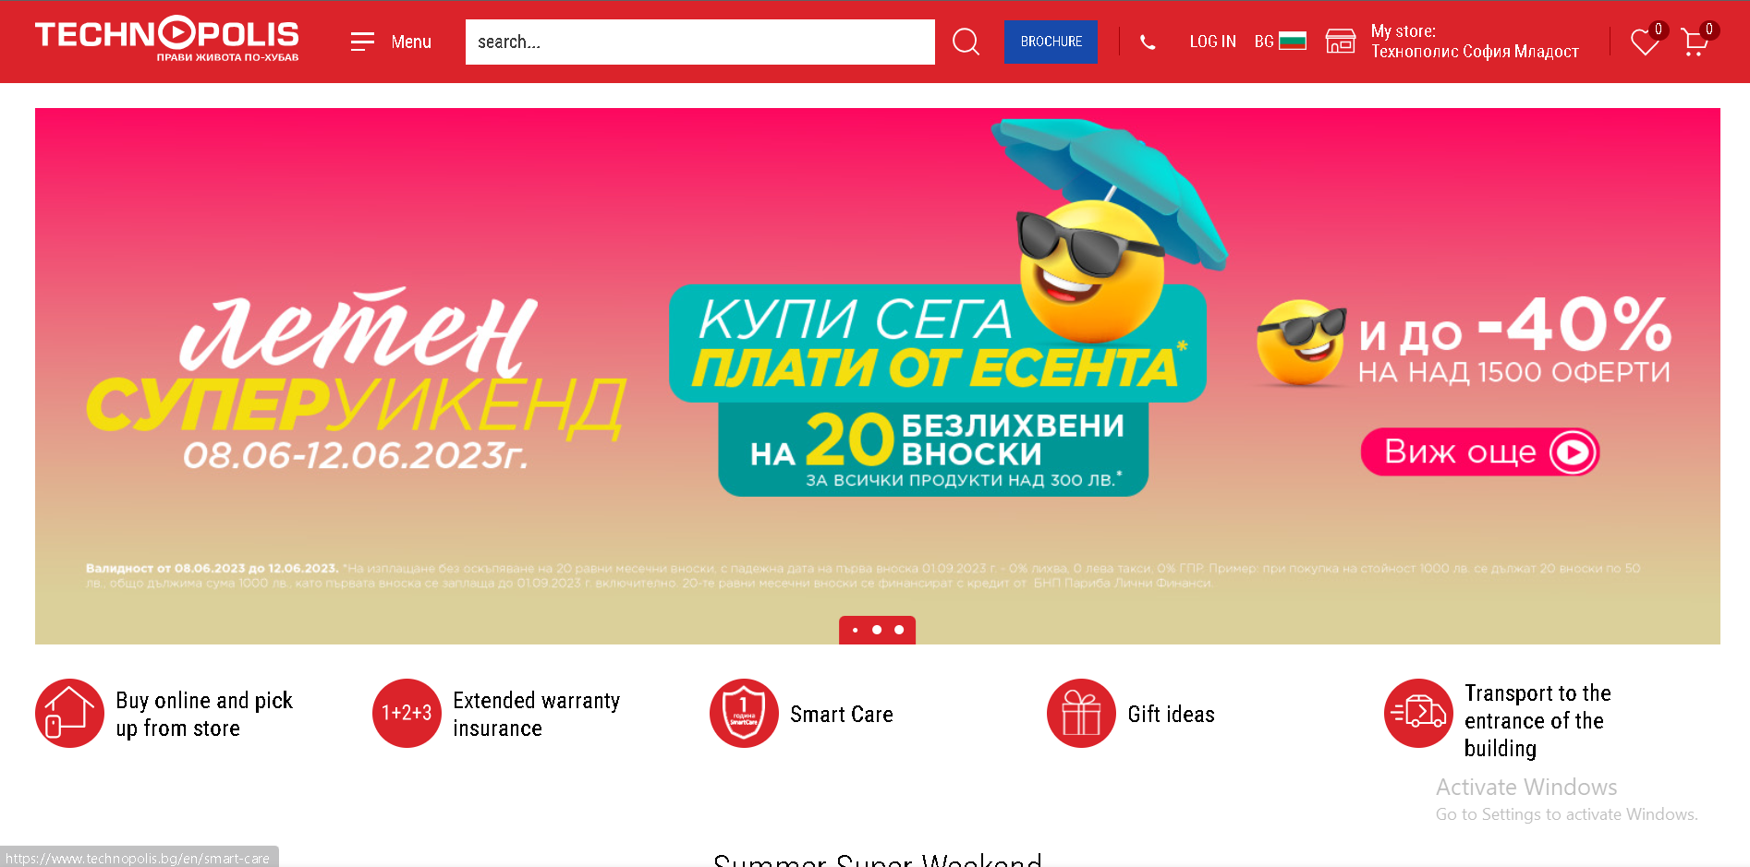
Menu - Technopolis
Technopolis has a drop down menu as well as a search bar on the top of the screen. The search options are also “sticky” so they stay on top of the screen as you scroll
You can also switch the site’s language to English if you can’t read Bulgarian!

Slide 5
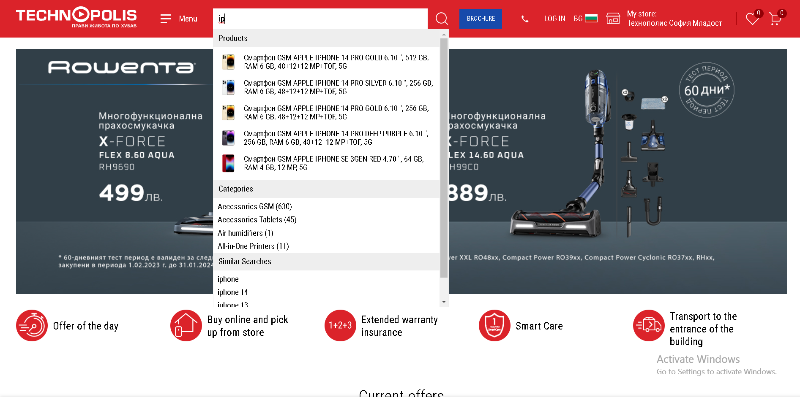
Menu - Technopolis
When you type you get products that fit your search, as well as categories and “similar searches”

Slide 6
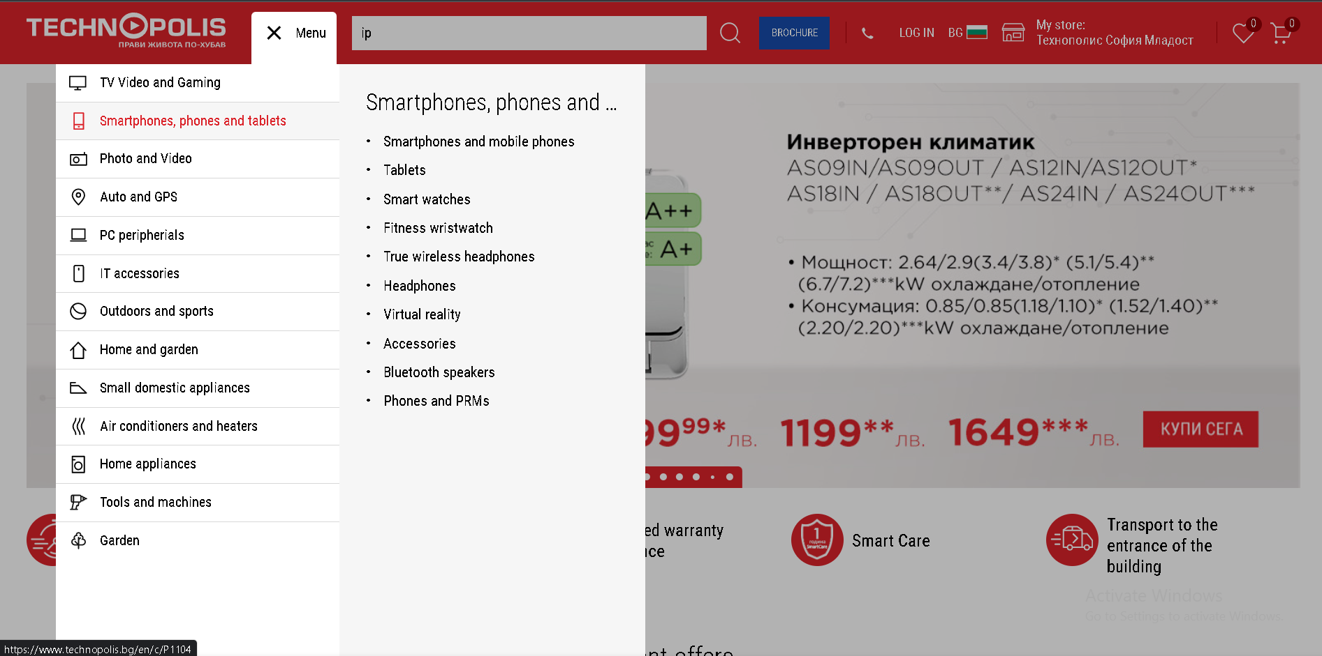
Menu - Technopolis
In the menu there are various categories / sub-categories

Slide 7
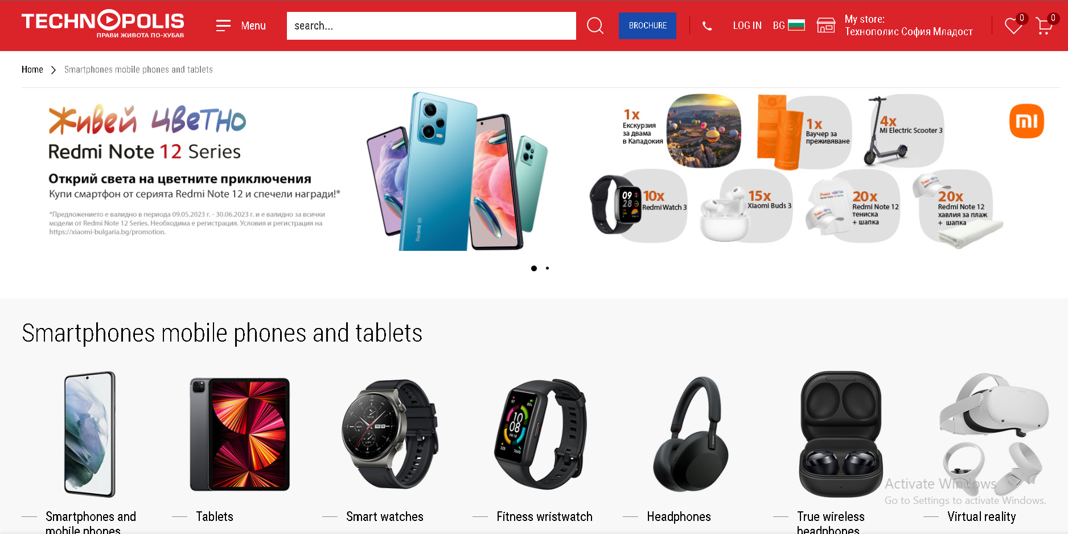
Menu - Technopolis
After you click on a category, you get a page of various sub-categories

Slide 8
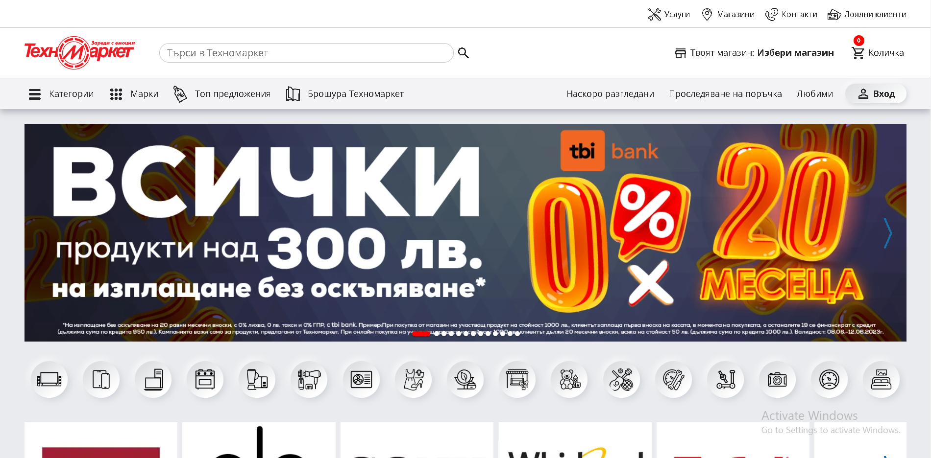
Menu - Technomarket
Technomarket has a drop down menu as well as a search bar on the top of the screen. The search options are also “sticky” so they stay on top of the screen as you scroll, just like Technopolis
However, you cannot change the language of the website. BOOOO ☹
(I’ve used “translate page” option on google chrome in the next images)

Slide 9
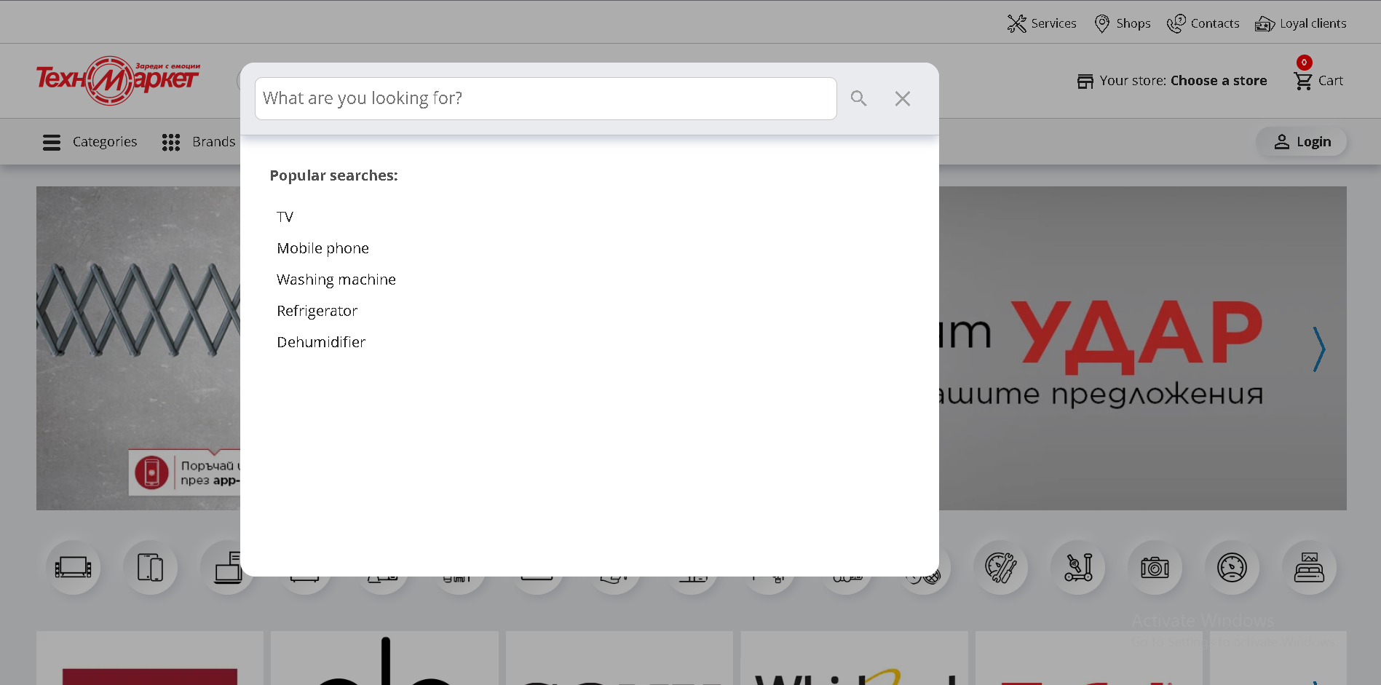
Menu - Technomarket
It has a similar search function to Technopolis, but when you click on the search bar, it defocuses the rest of the site

Slide 10
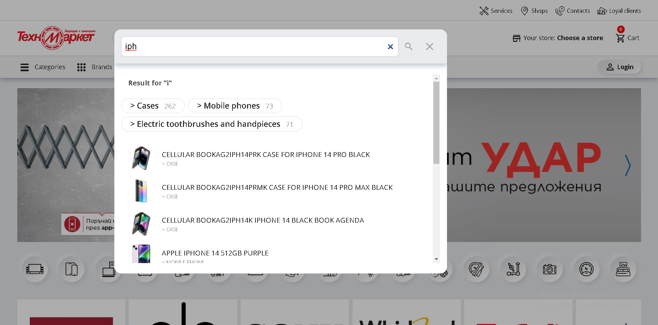
Menu - Technomarket

Slide 11
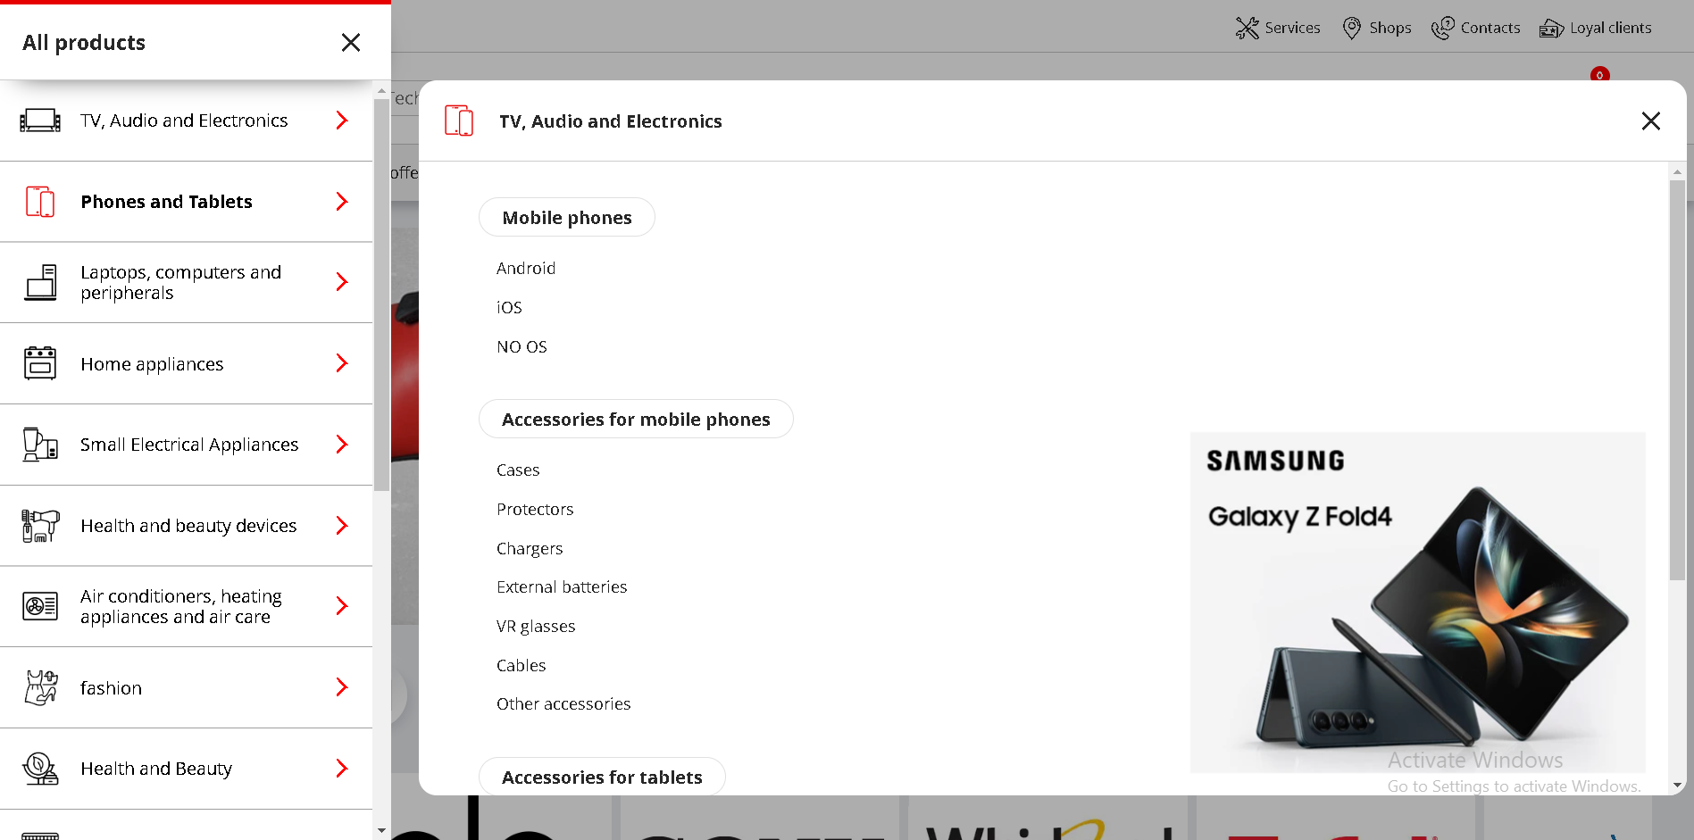
Menu - Technomarket
The menu also has a right portion to it with images, but its only 1 promotional image, and all the text is really spread out and requires a lot of scrolling

Slide 12
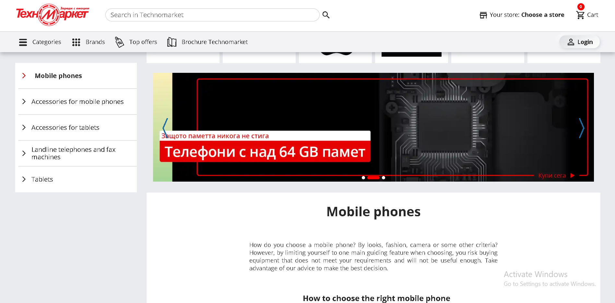
Menu - Technomarket
You can’t click on the big categories like “Smarthpones and Tablets”, when you click on a sub-category you start with an explanation of the items

Slide 13
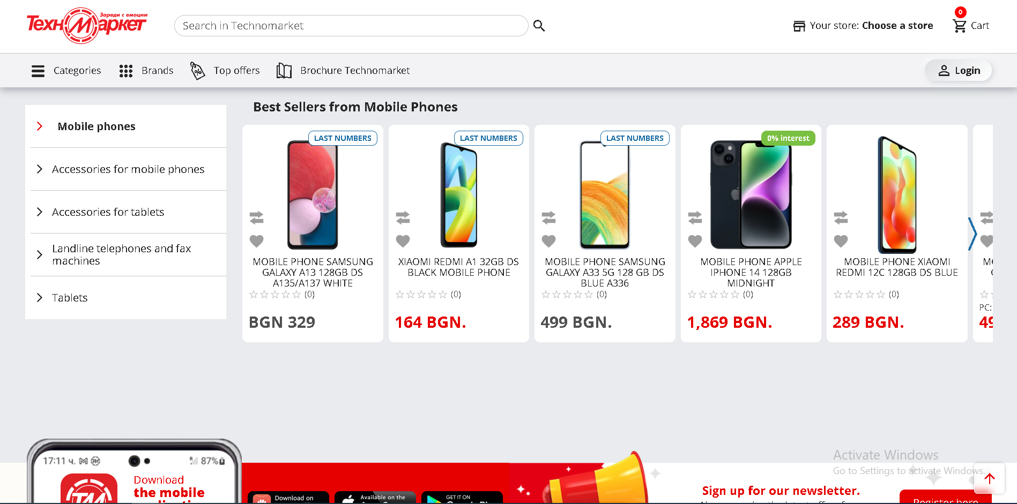
Menu - Technomarket
You have to scroll down to get suggestions in the actual category, but even then its not the full results. The description for the category is also not really helpful

Slide 14
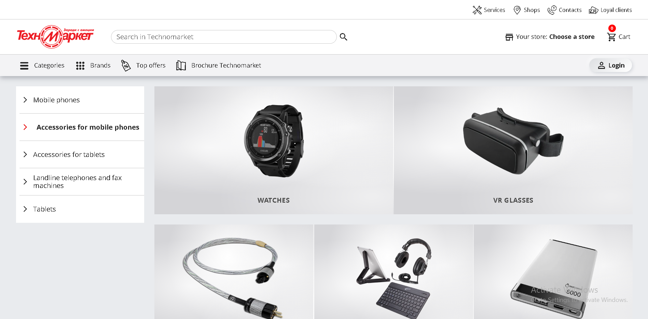
Menu - Technomarket
Some categories also don’t have suggestions and just bring you to a page with just sub-categories you can choose

Slide 15
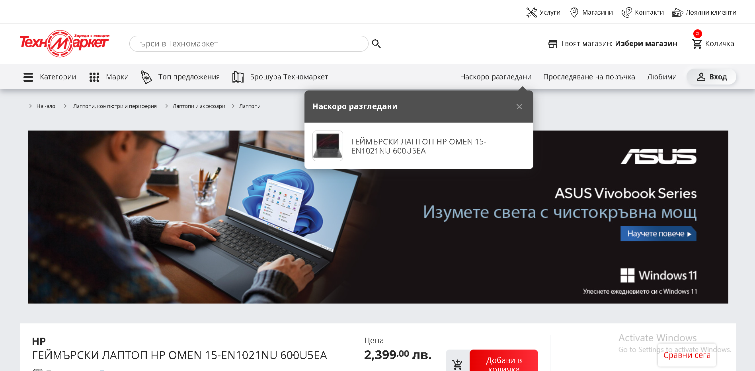
Menu - Technomarket
There’s also 3 extra menus for “Recently viewed”, “Delivery status” and “Favorites”, but it’s not visible when you translate the page

Slide 16
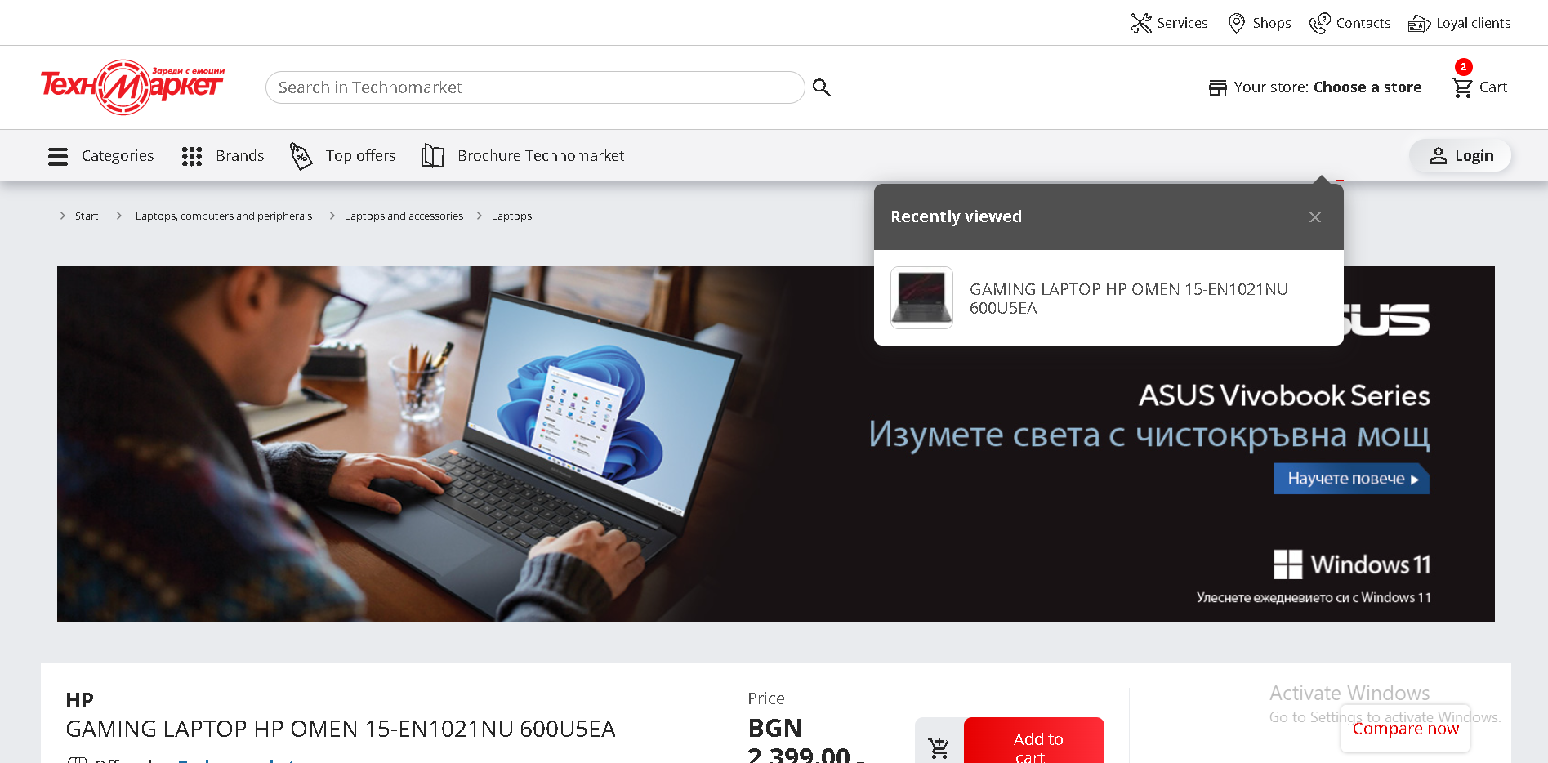
Menu - Technomarket
There’s also 3 extra menus for “Recently viewed”, “Delivery status” and “Favorites”, but it’s not visible when you translate the page

Slide 17
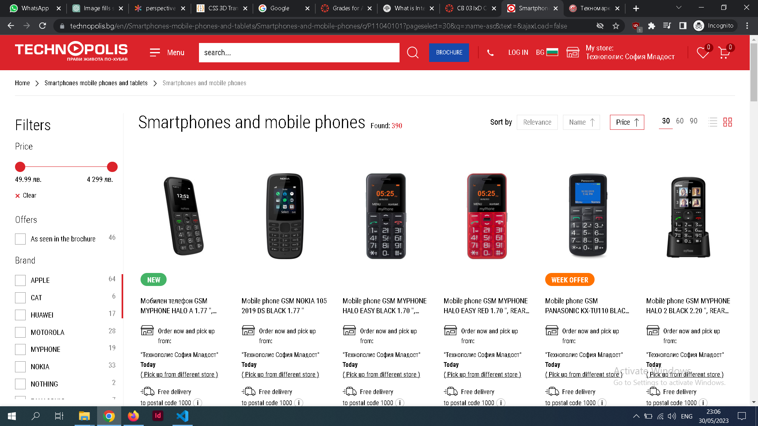
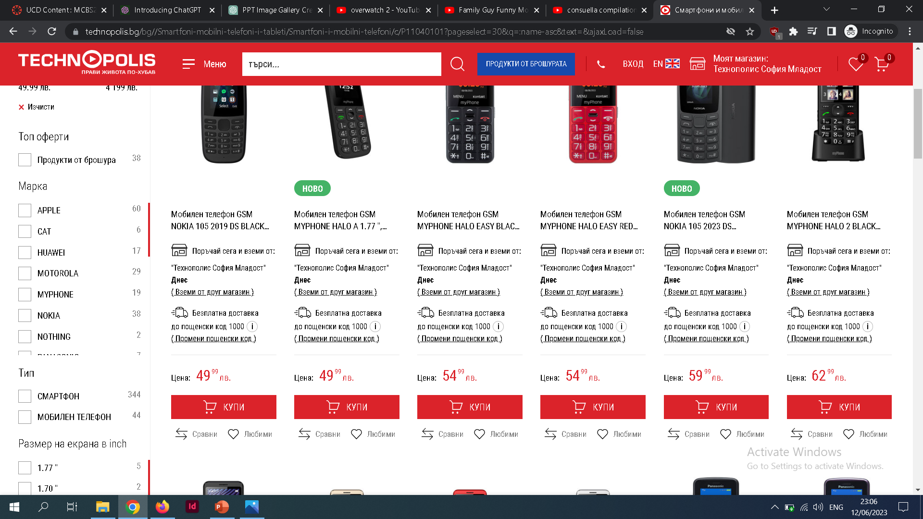
Filter - Technopolis
When you select a category you get a grid display with some filters on the left and the items on the right. You can either add open item, compare it or add it to your favorites
You can sort by relevance, Name and Price. You can also display between 30-60-90 items per page

Slide 18
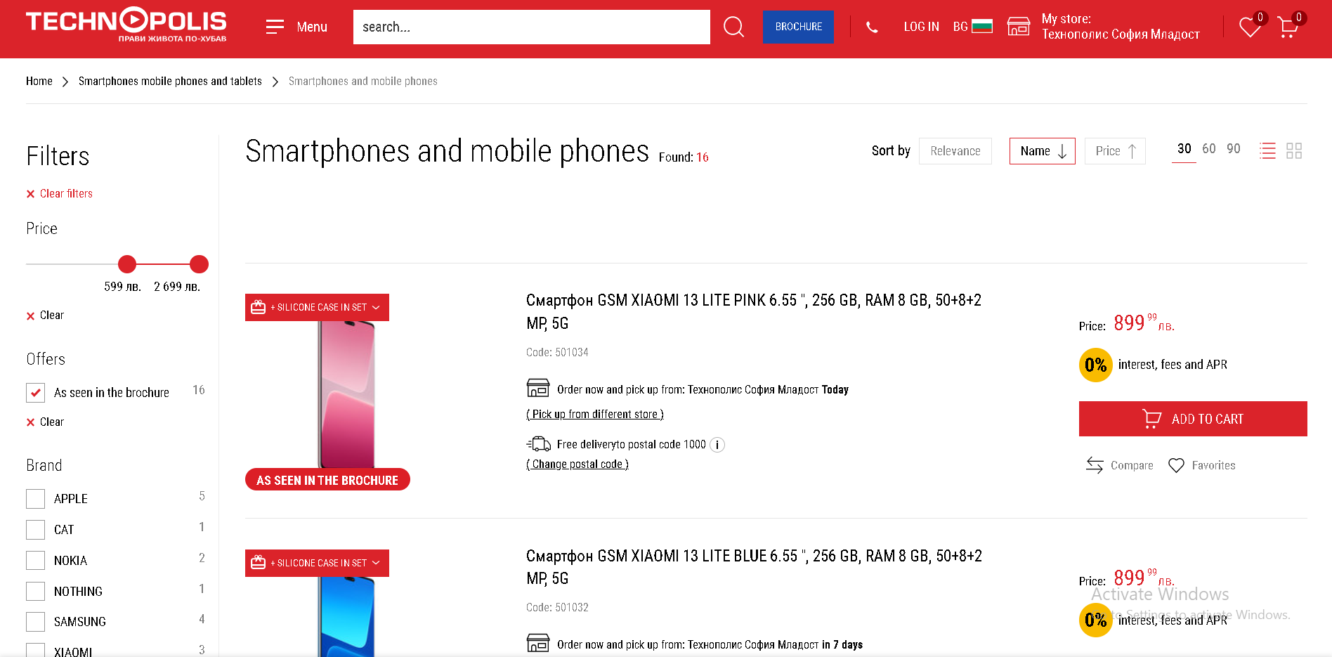
Menu - Technopolis
You can also show your items in a list display

Slide 19
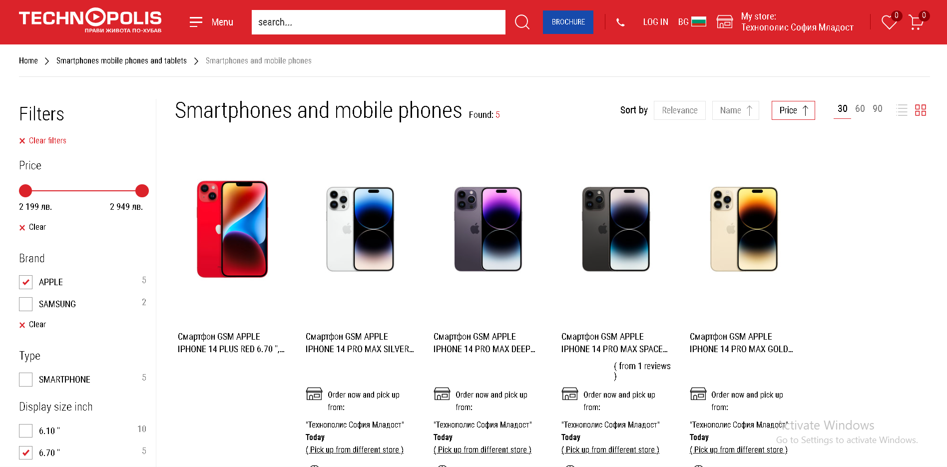
Menu - Technopolis
The price range is a slider and the filters are all checkboxes that refresh the page and lower the available options. You can’t easily uncheck filters on top of the screen

Slide 20
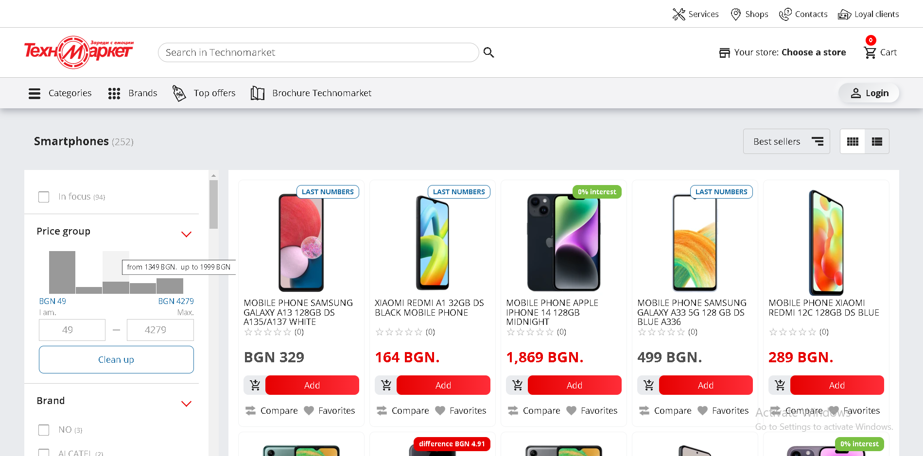
Filter - Technomarket
When you select a category you get a grid display with some filters on the left and the items on the right, just like Technopolis. You can either add open item, compare it or add it to your favorites

Slide 21
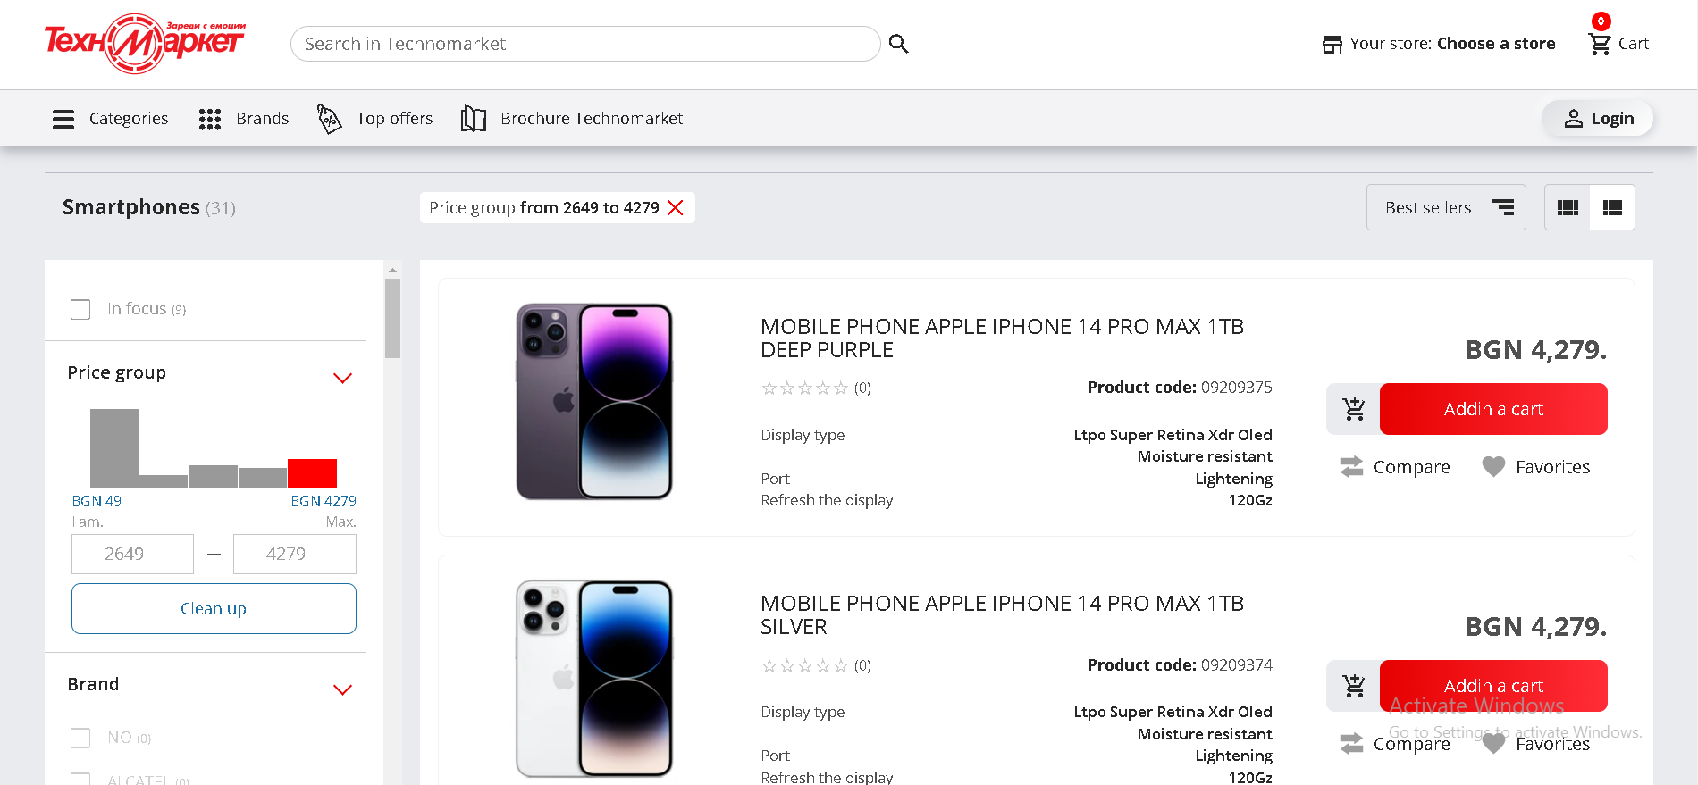
Menu - Technomarket
You can also change the items to be displayed as a list with more details compared to Technopolis. The price also can be manually set instead of having a slider

Slide 22
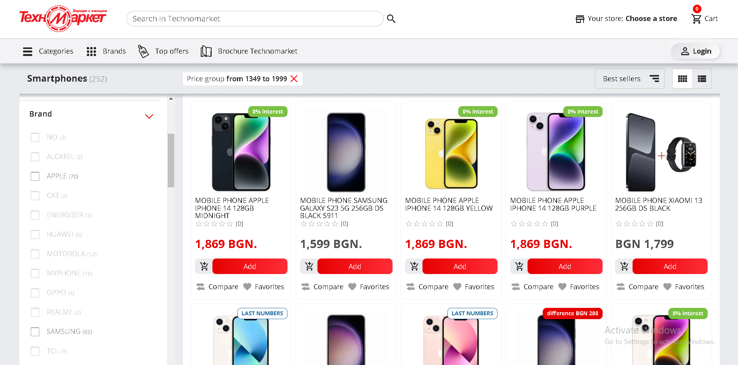
Menu - Technomarket
On the left everything besides the price range is a checkbox. Selecting one refreshed the page and narrows down your options for other choices. However, the color makes it hard to read

Slide 23
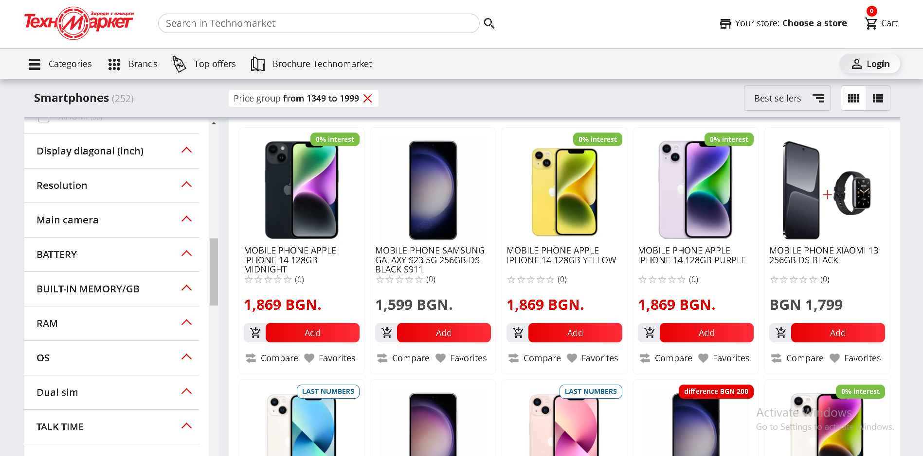
Menu - Technomarket
There are plenty of things to filter your results by, and you can always remove one of them at the top of the search result

Slide 24
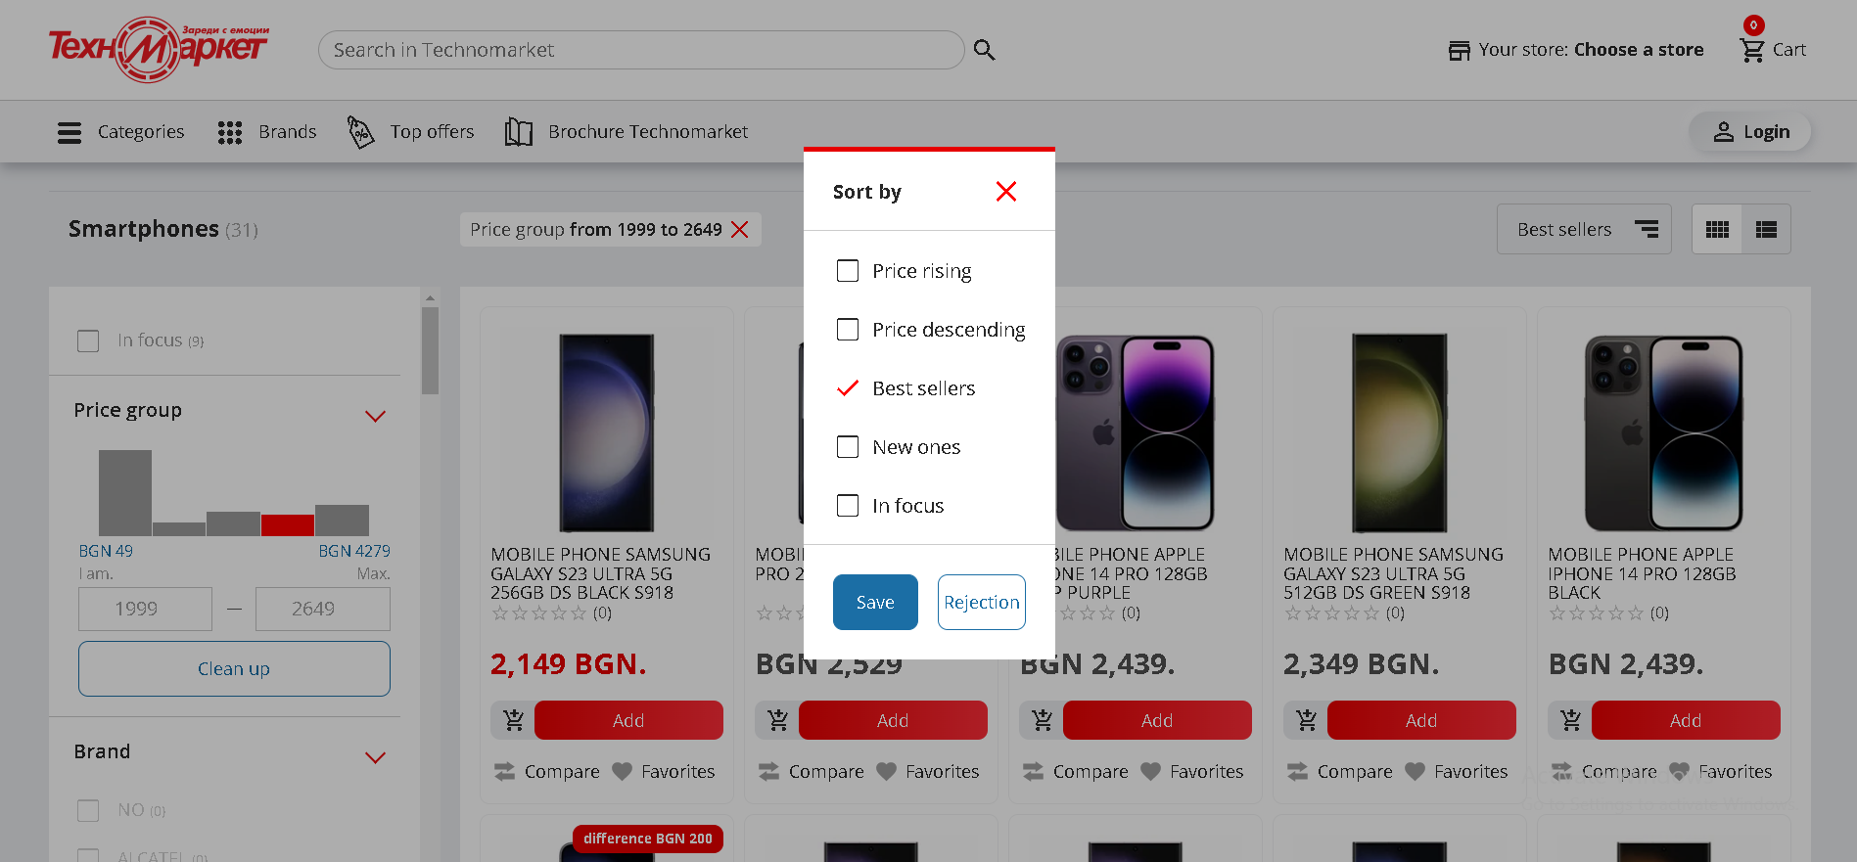
Menu - Technomarket
When you click on the sorting you get a dialog box that grays out the rest of the page with a few checkboxes (when it should be radio buttons or no boxes at all)

Slide 25
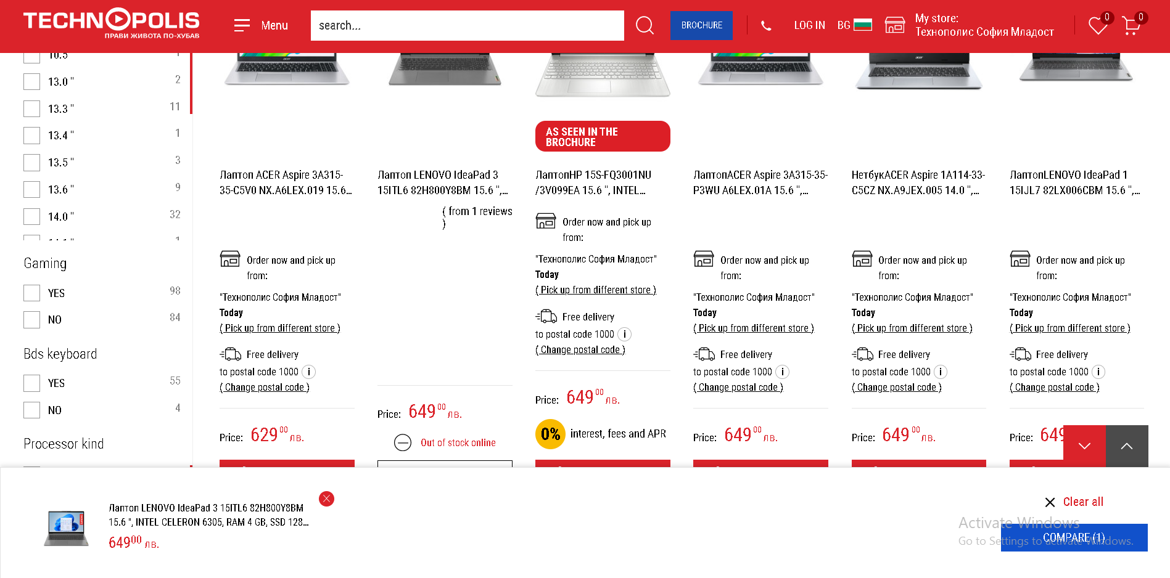
Compare - Technopolis
To initiate a comparison, you have to click on the “compare” button on an item (can only be in one category) and it gets added to the bottom of the screen

Slide 26
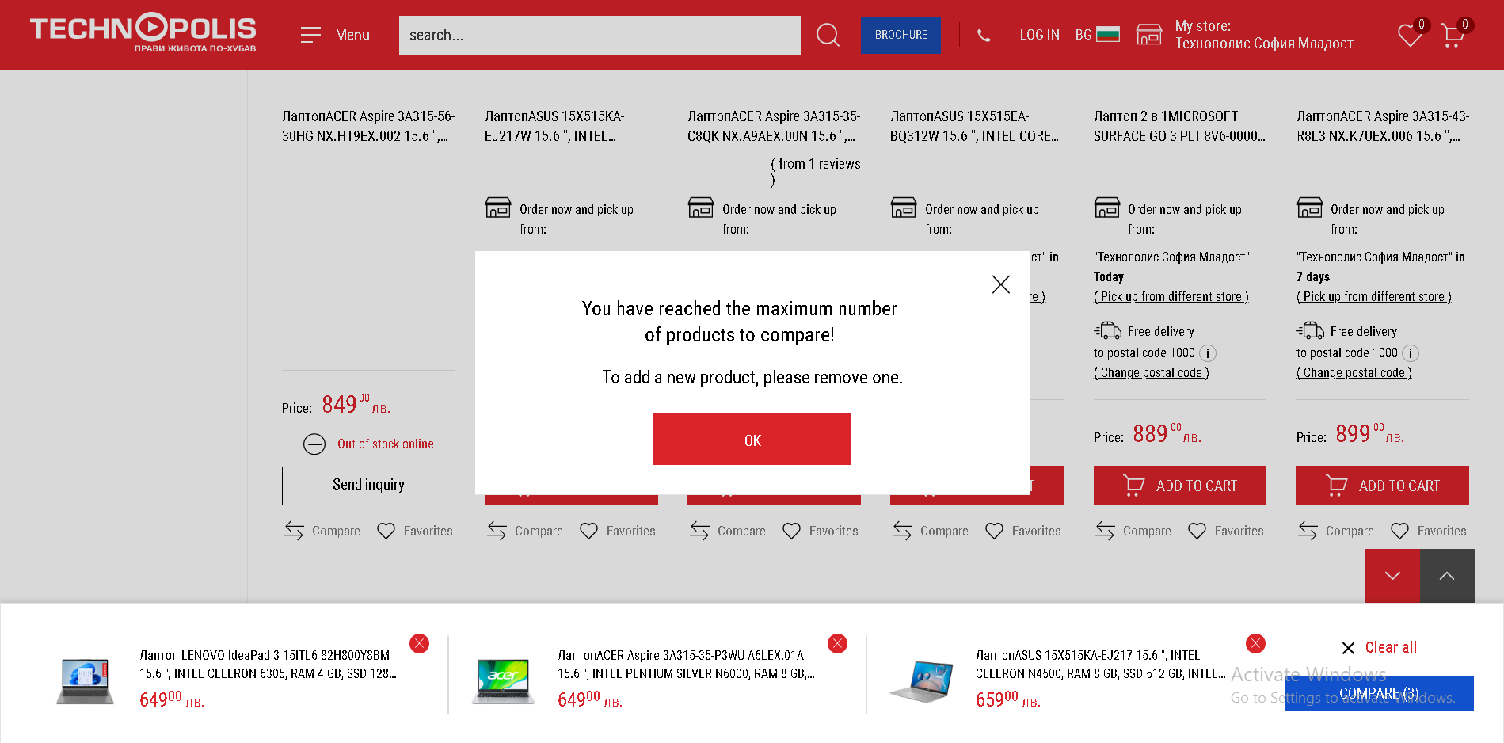
Compare - Technopolis
You can only have up to 3 products however so choose wisely!

Slide 27
Compare - Technopolis
You can only have up to 3 products however so choose wisely!

Slide 28
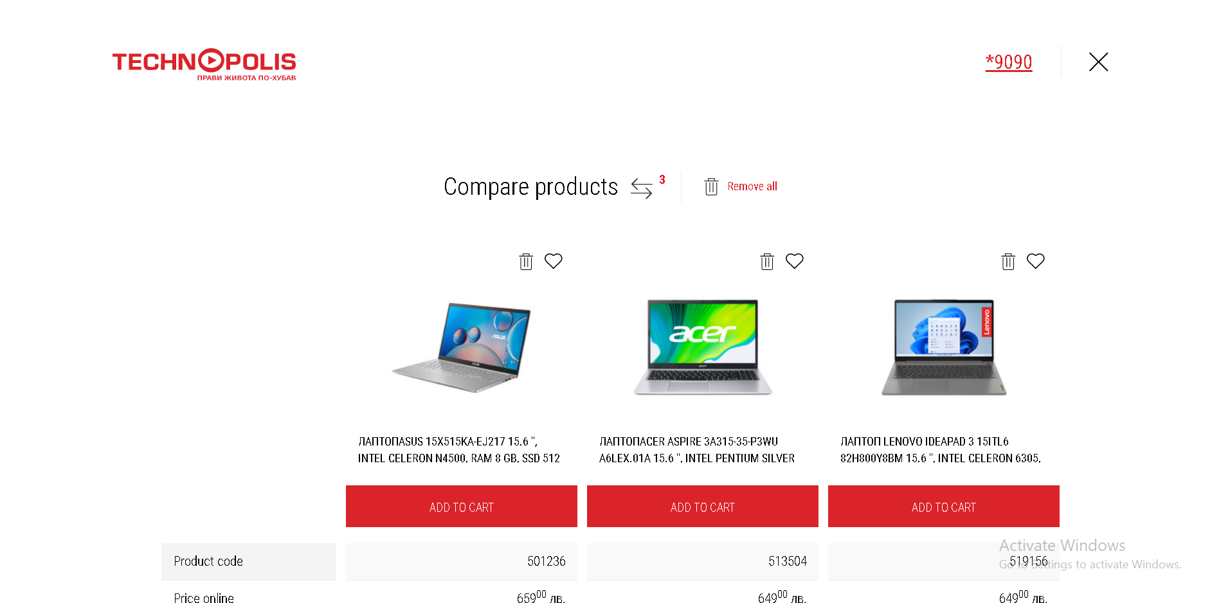
Compare - Technopolis
When you click on the compare, you go to a page with your items and no site header. You can favorite, remove from comparison or add the item to your cart

Slide 29
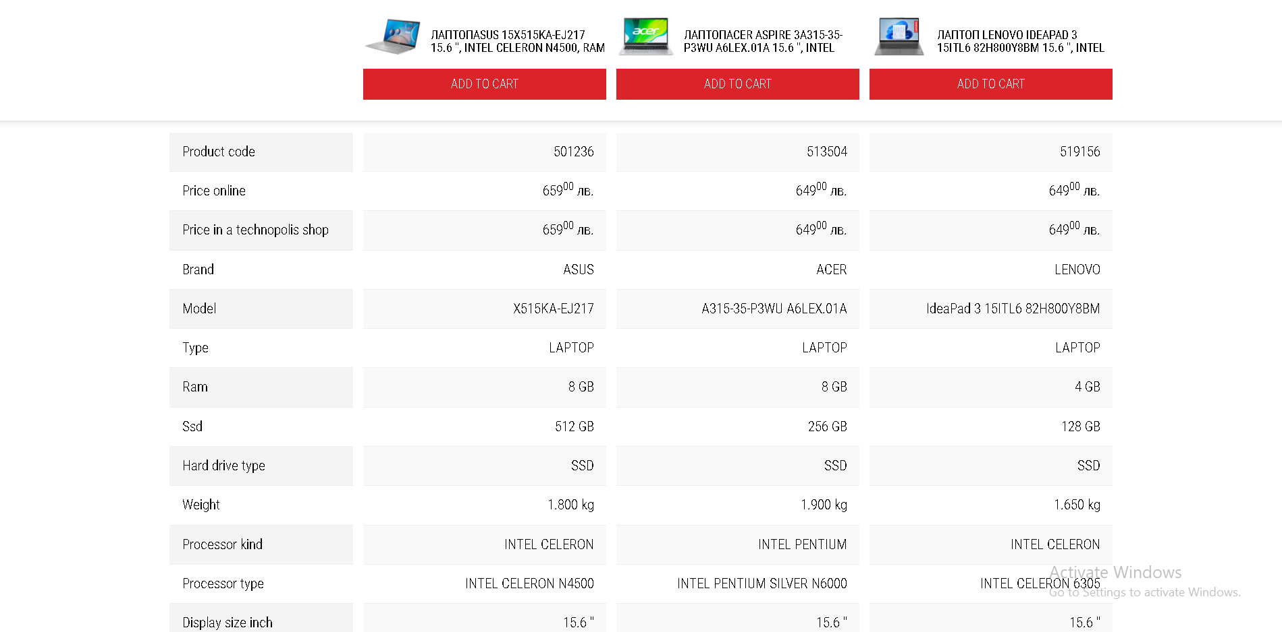
Compare - Technopolis
When you scroll, you see the specs they’re compared by, as well as the items on the top with “add to cart” and the name + link to a detailed product page

Slide 30
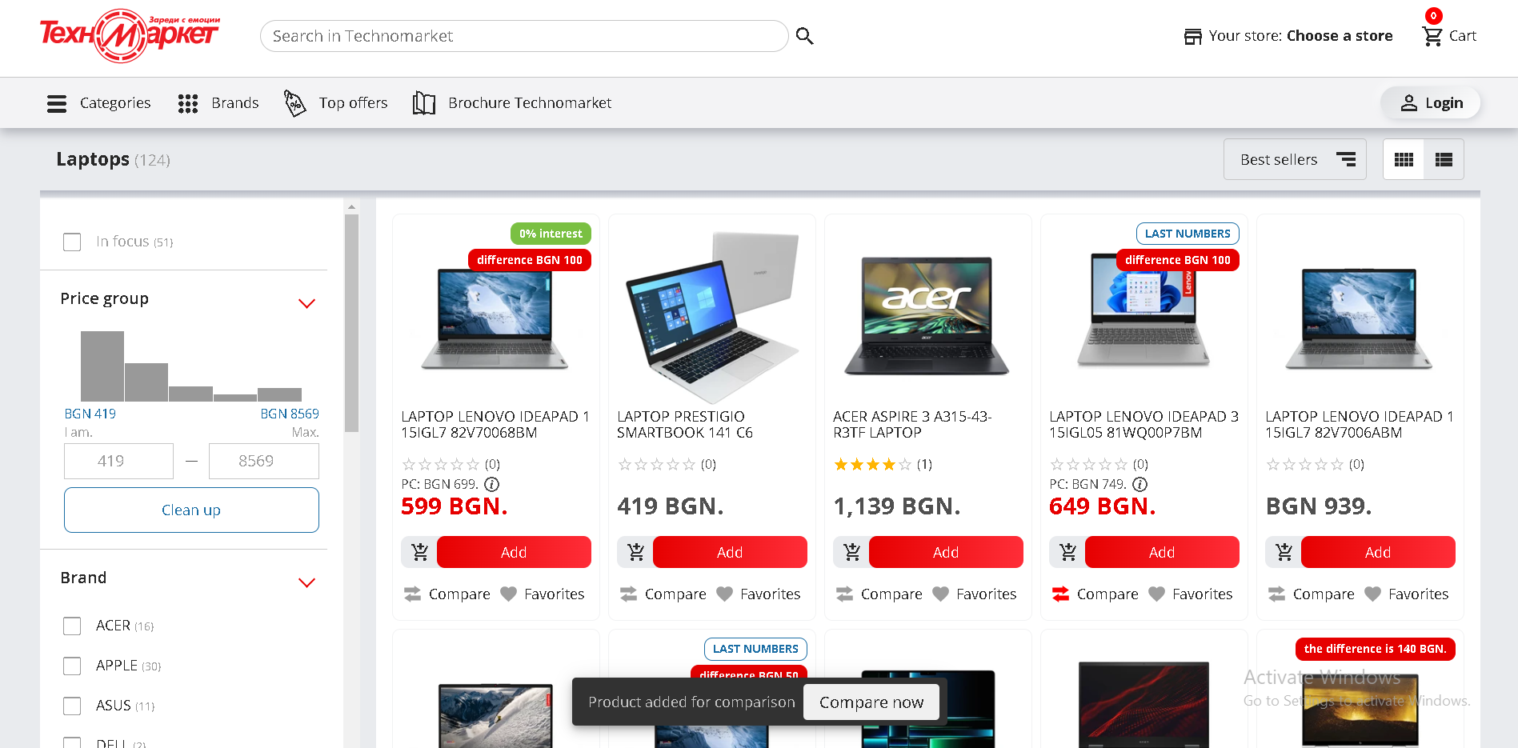
Compare - Technomarket
To initiate a comparison, you have to click on the “compare” button on an item (can only be in one category). It shows a brief small pop-up at the bottom of the screen.

Slide 31
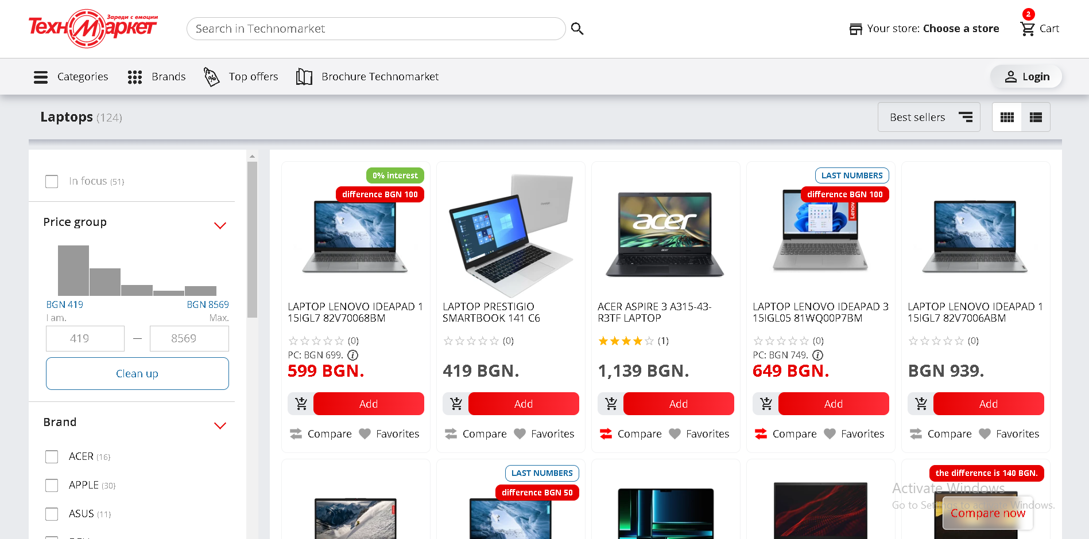

Compare - Technopolis
After the notification disappears there’s a small button on the bottom right, but it’s easy to miss

Slide 32
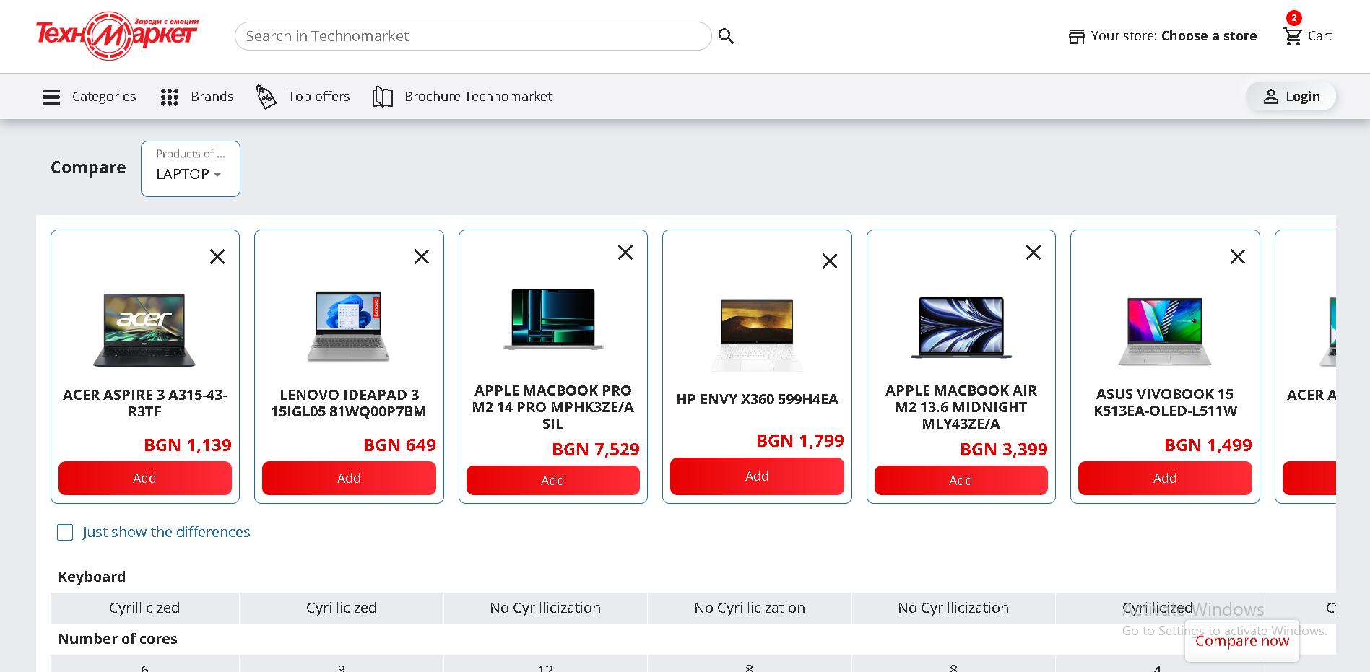
Compare - Technopolis
After you click the compare button, you get sent to a page with all your items, up to 8 of them

Slide 33
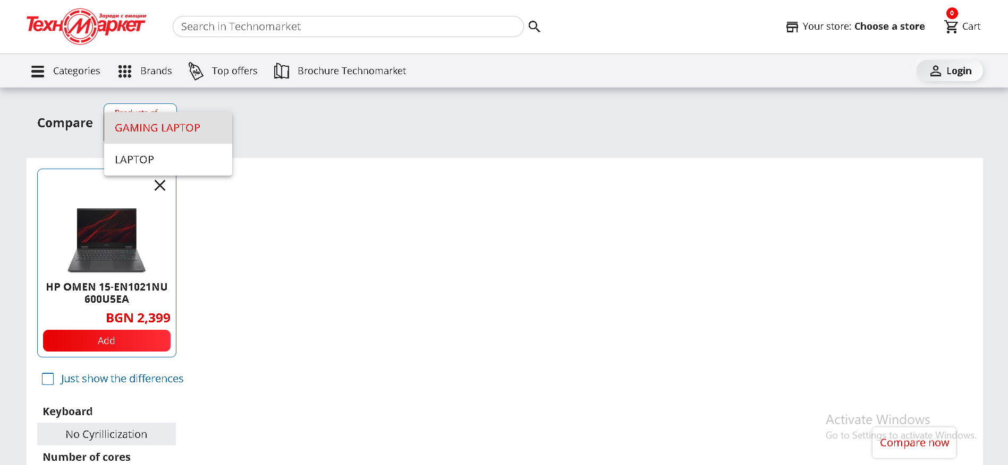
Compare - Technopolis
You can switch between categories on the top left, although it is a bit buggy

Slide 34
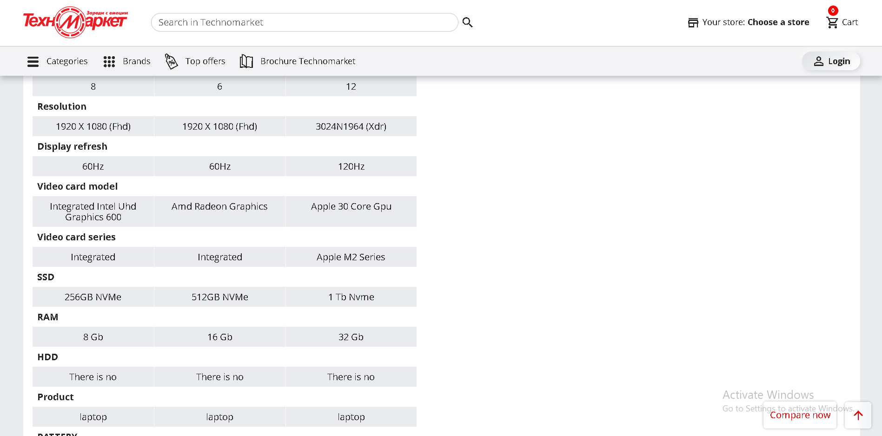
Compare - Technopolis
When you scroll down you can see more details on each category, however you can’t see what item is what, you have to scroll back

Slide 35
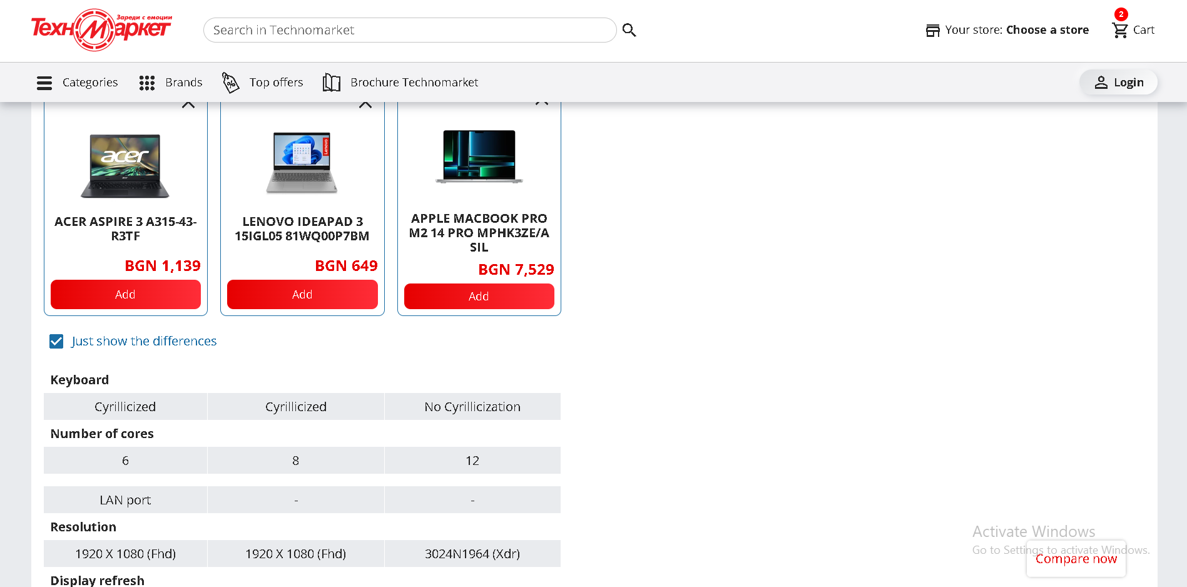
Compare - Technopolis
You can also click on “show differences” only to show you only the different categories

Slide 36
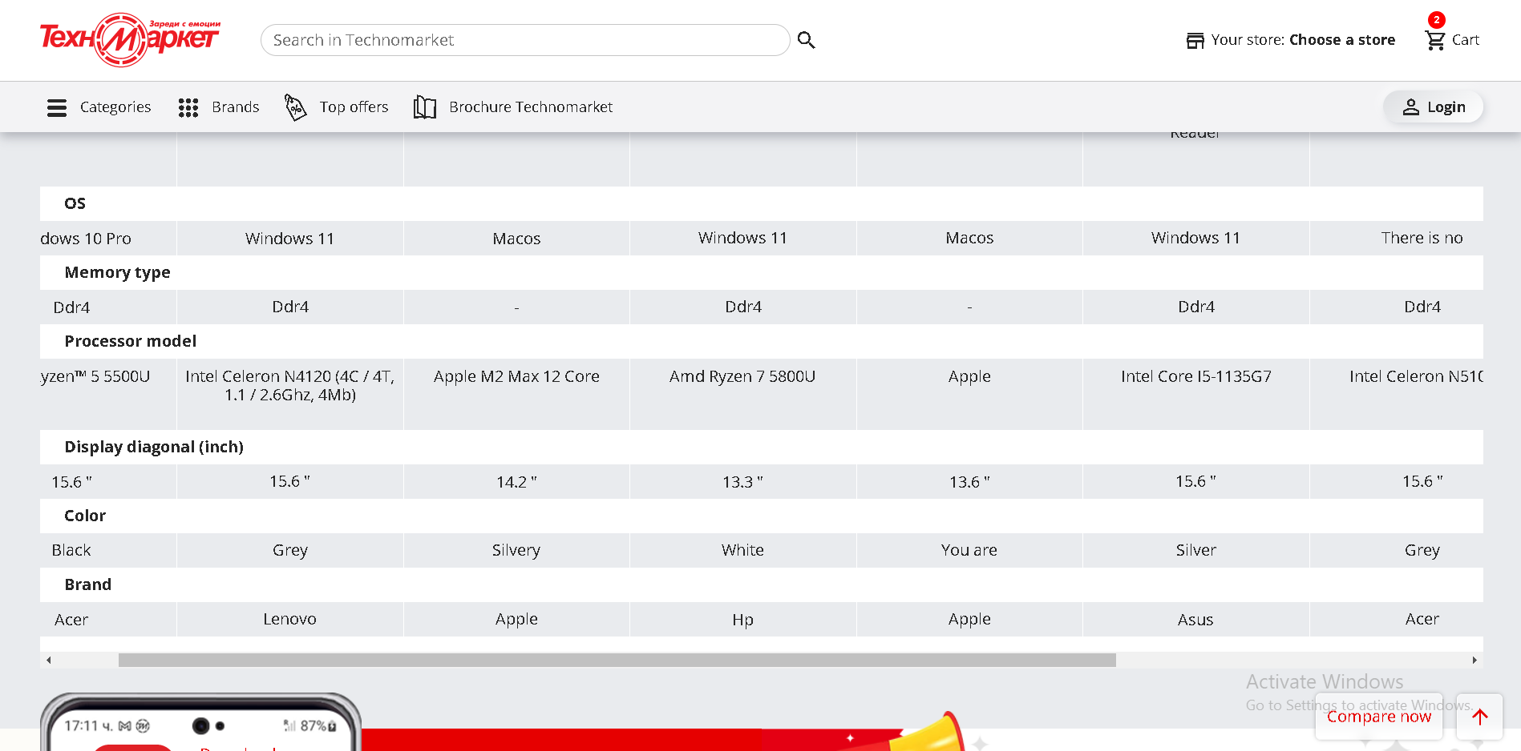
Compare - Technopolis
If you add too many items you have to scroll horizontally, but the scroll bar is at the bottom so you have to scroll all the way to the bottom to compare items

Slide 37
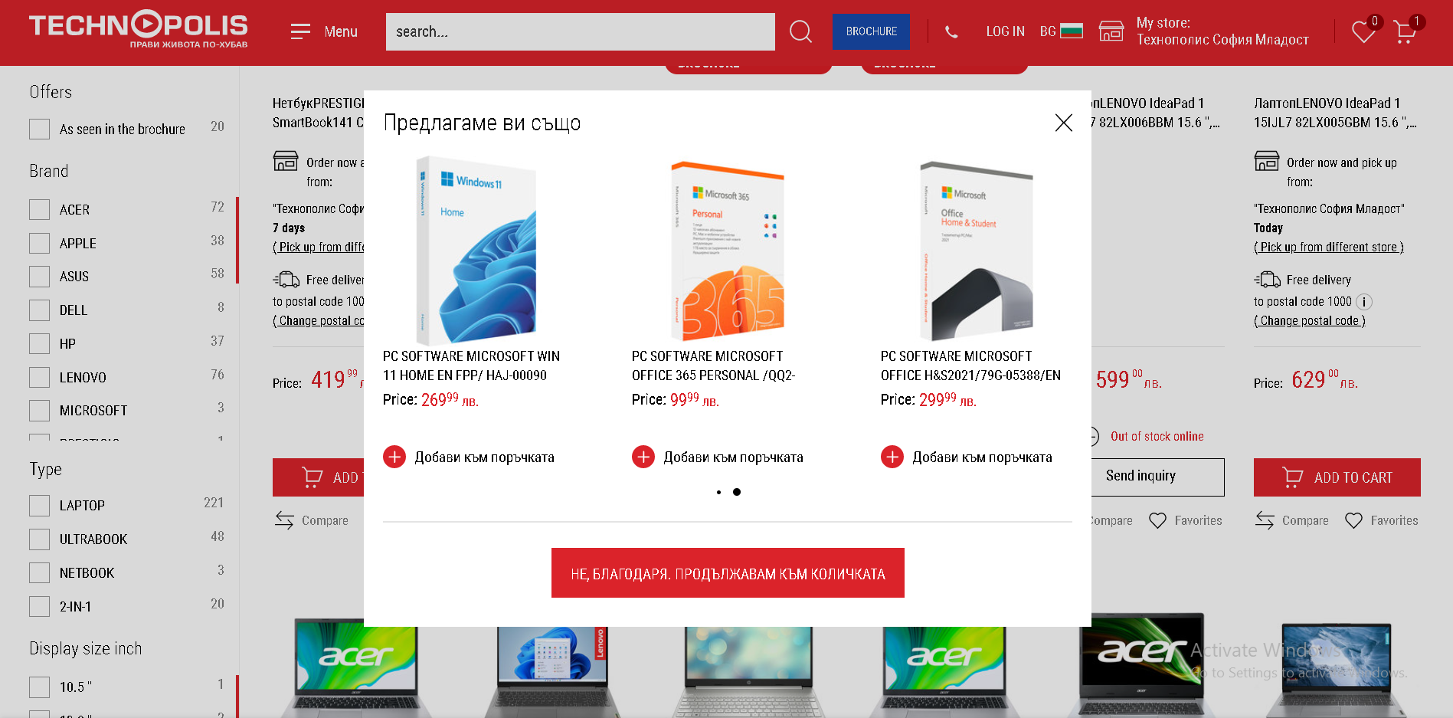
Cart -Technopolis
After you click on an item, it either takes you to the cart total/checkout page, or you get a suggestion for something else to buy that might be relevant to your purchase
This could be really annoying if you want to purchase multiple items, since it takes you to a different page

Slide 38
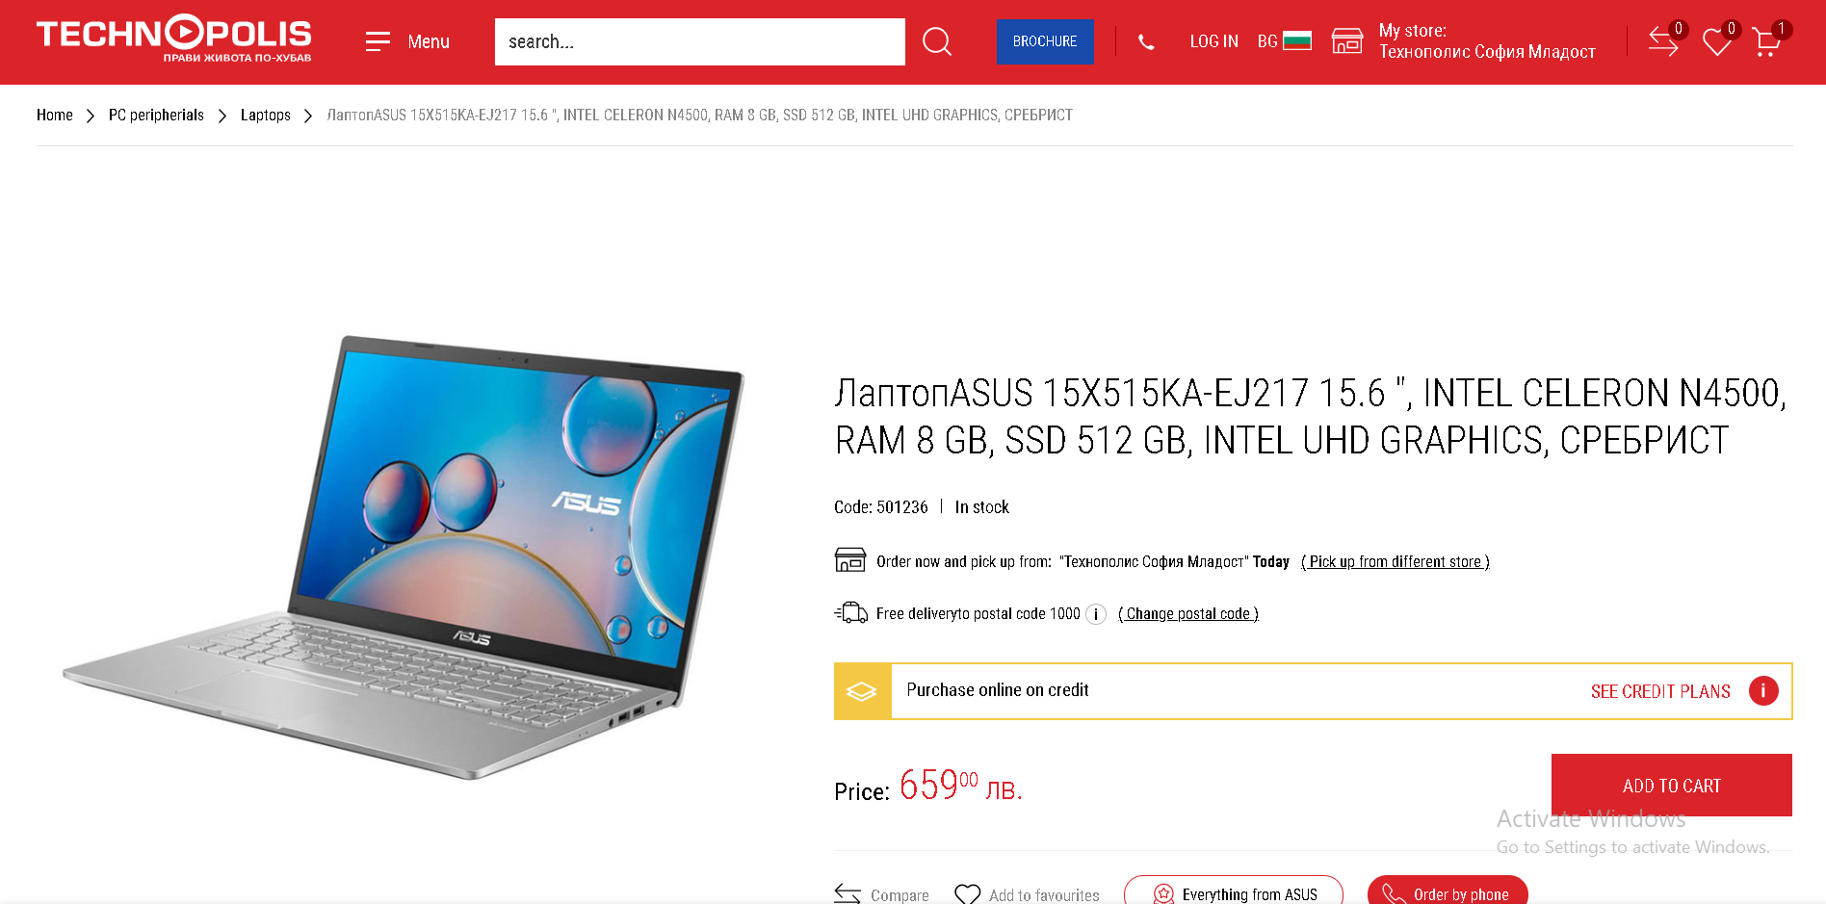
Cart - Technopolis
You can also go to the product page to check out detailed plans for deterred payment (you can do this in the checkout as well)

Slide 39
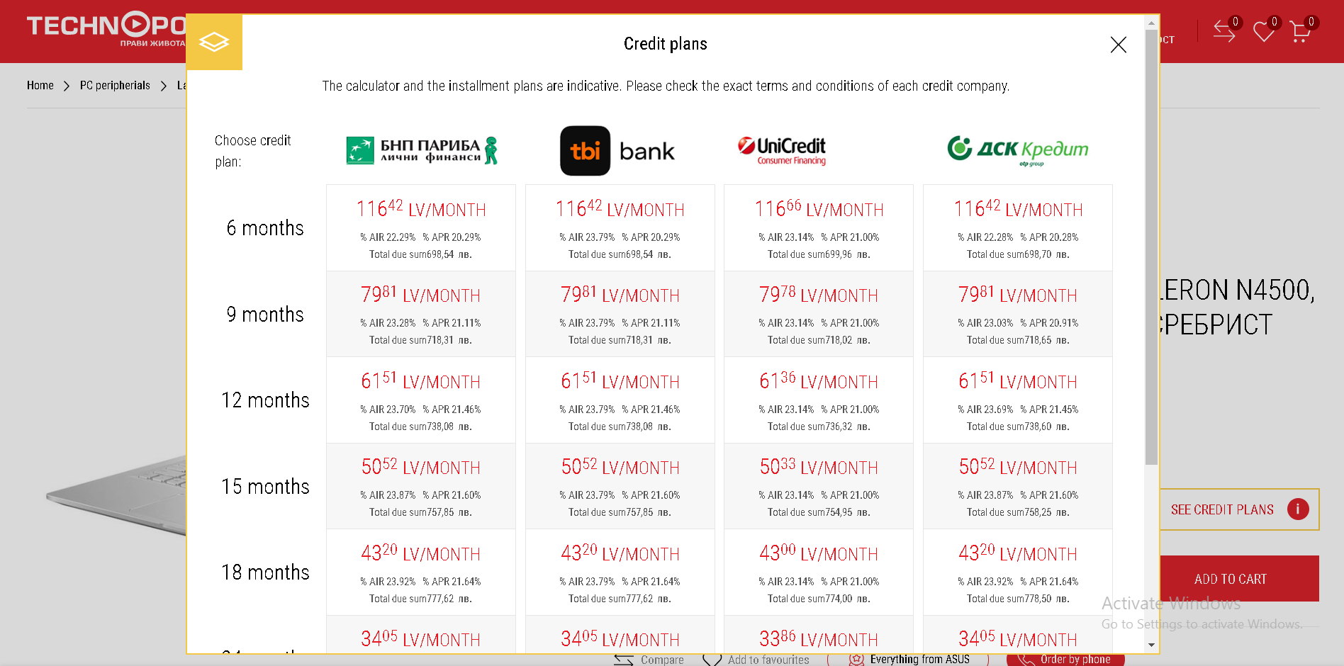
Cart - Technopolis

Slide 40
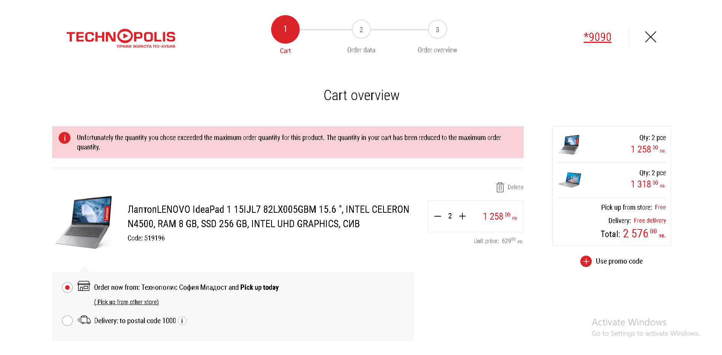
Cart - Technopolis
On the cart page, you can see an overview of your items as well as a promo code discount. You can select delivery to store or address. You can delete and change quantity. You also get an error if you go over the maximum available quantity for an item

Slide 41
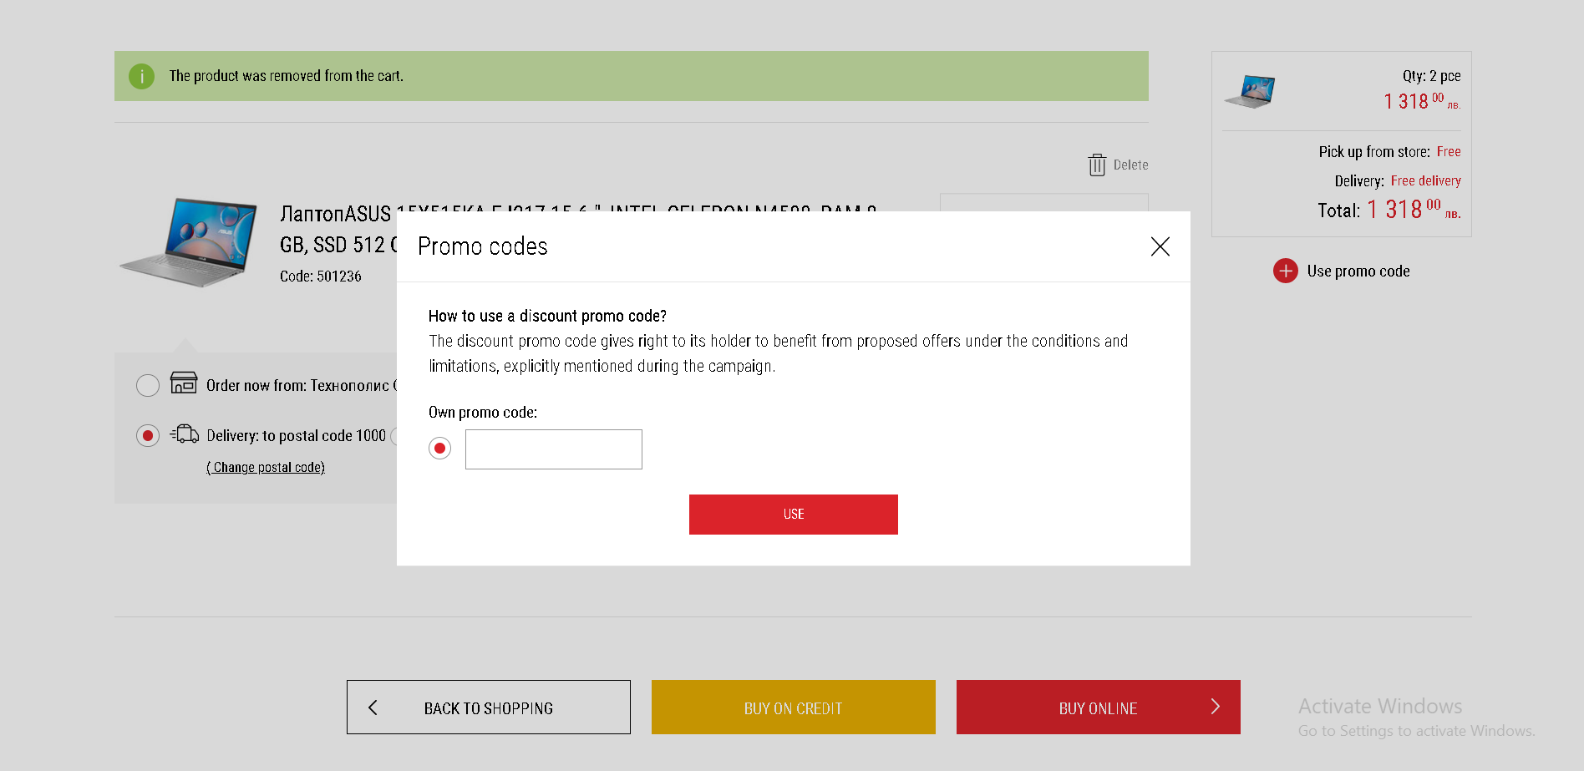
Cart - Technopolis

Slide 42
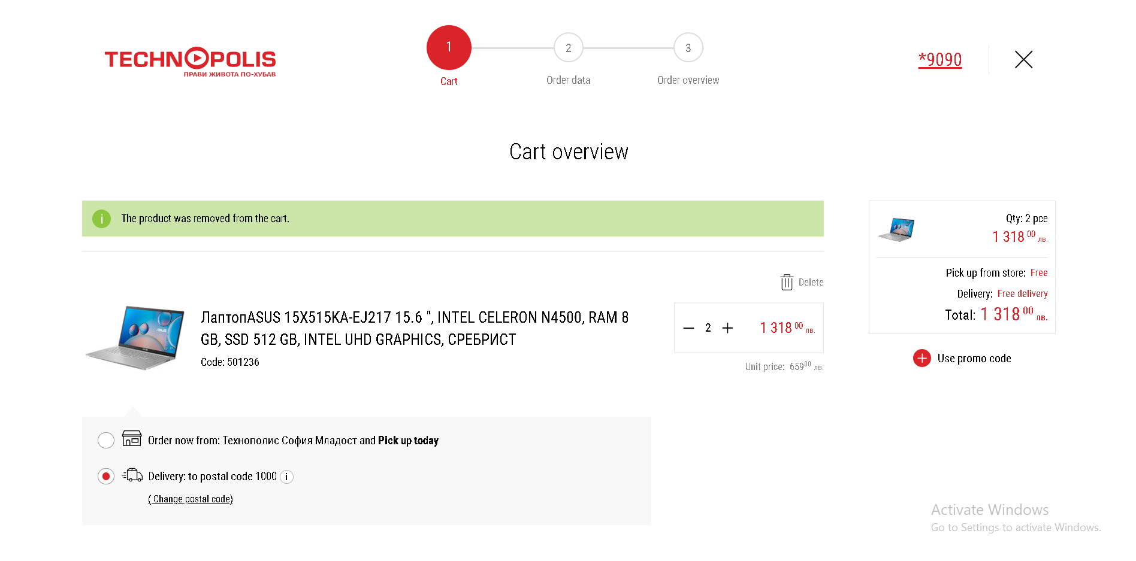
Cart - Technopolis
When you remove an item from the cart you get a notification about it

Slide 43
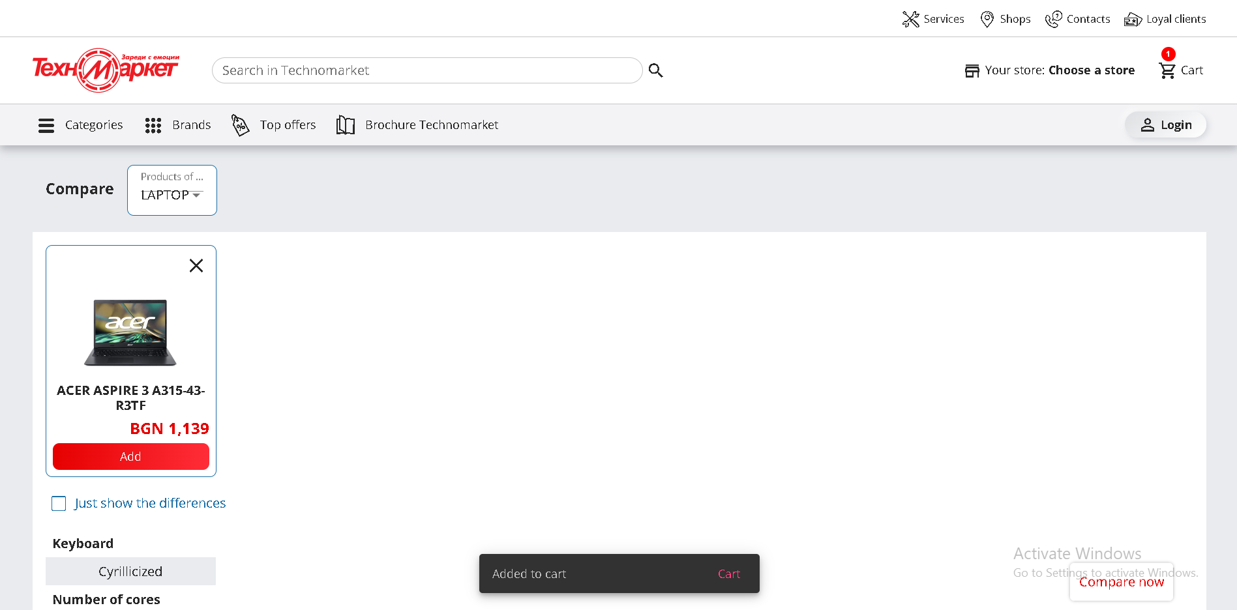
Cart -Technomarket
After you click on “add to cart” on an item, you get a small notification on the bottom that takes you to the cart page. You can also click the cart on the top right to go there

Slide 44
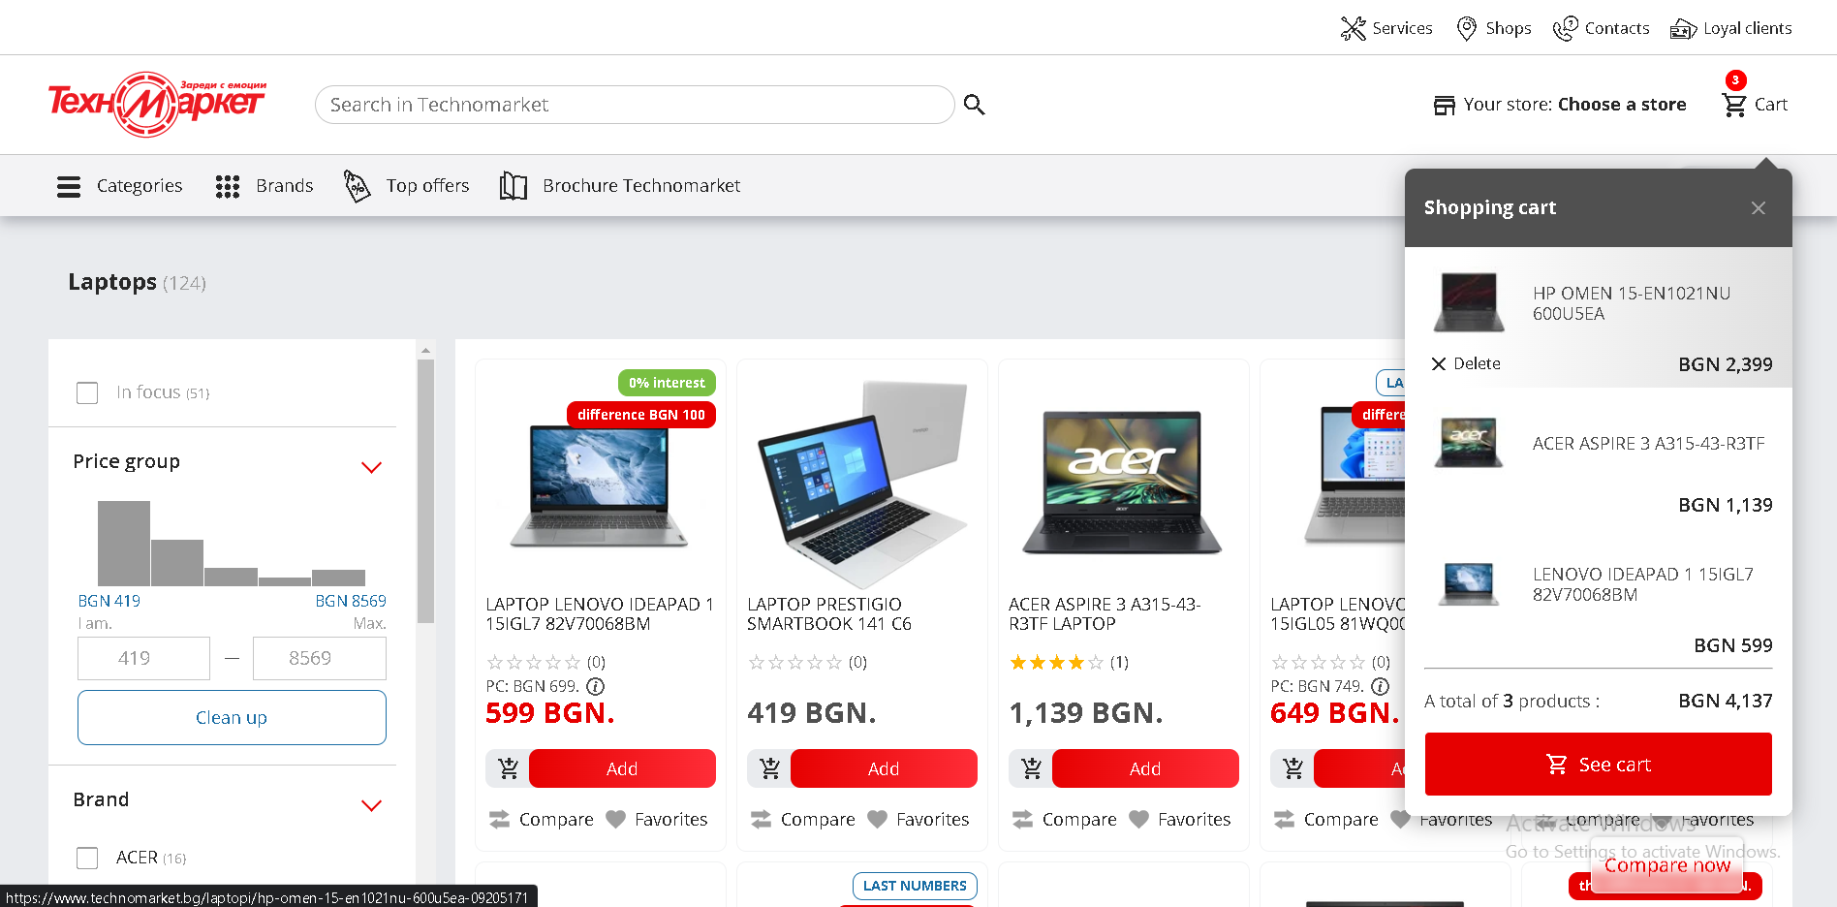
Cart - Technomarket
You can also delete items from the cart preview on the top right

Slide 45
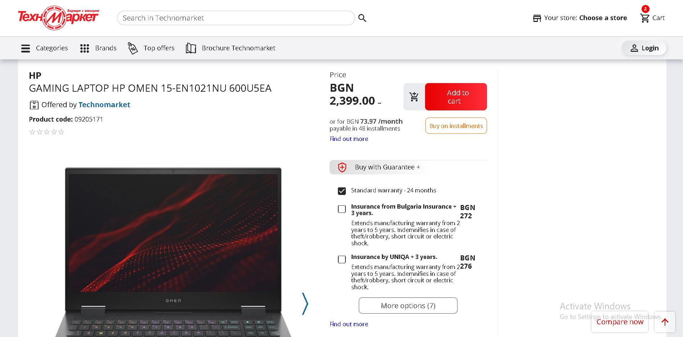
Cart - Technomarket
You can go to the product page, you can get more information about buying in installments + insurance

Slide 46
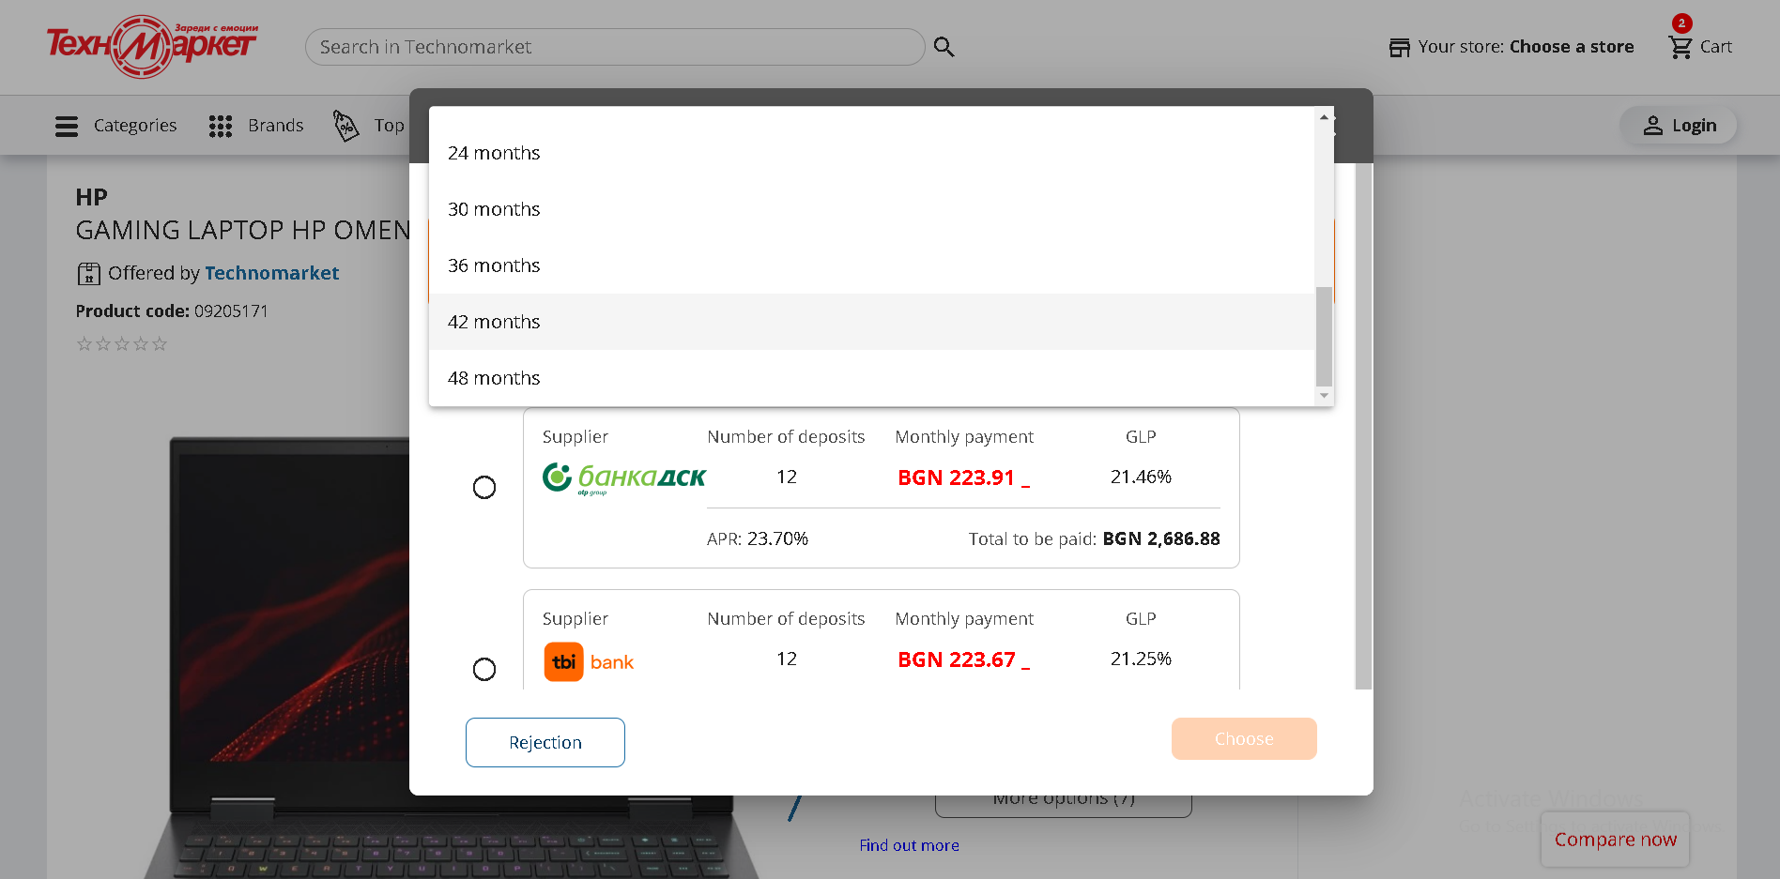
Cart - Technomarket
You also have a variety of payment options, month wise

Slide 47
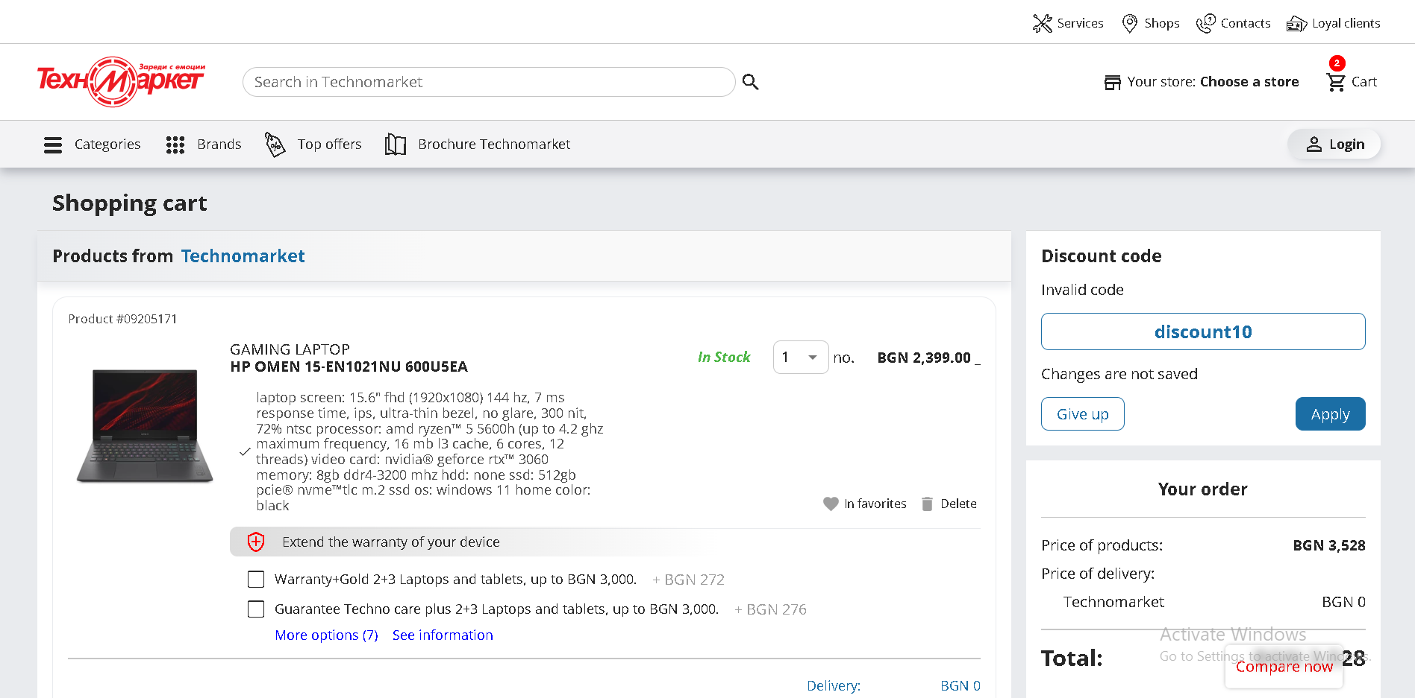
Cart - Technomarket
On the cart page you have your site header, items, item insurance, favorite/delete item and a discount code section

Slide 48
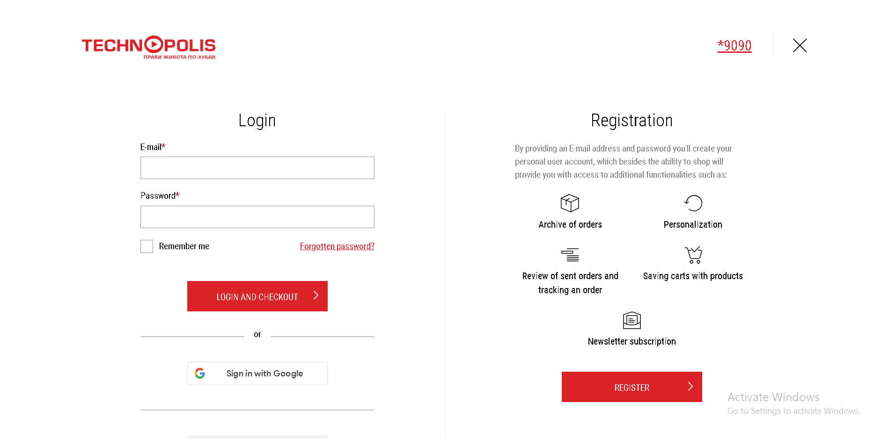
Checkout -Technopolis
When you click on the “Buy online” button in your cart, to get taken to the login page, if you haven’t logged in already. Logged in you can register on the right side.
You can also choose to login with your Google account instead

Slide 49
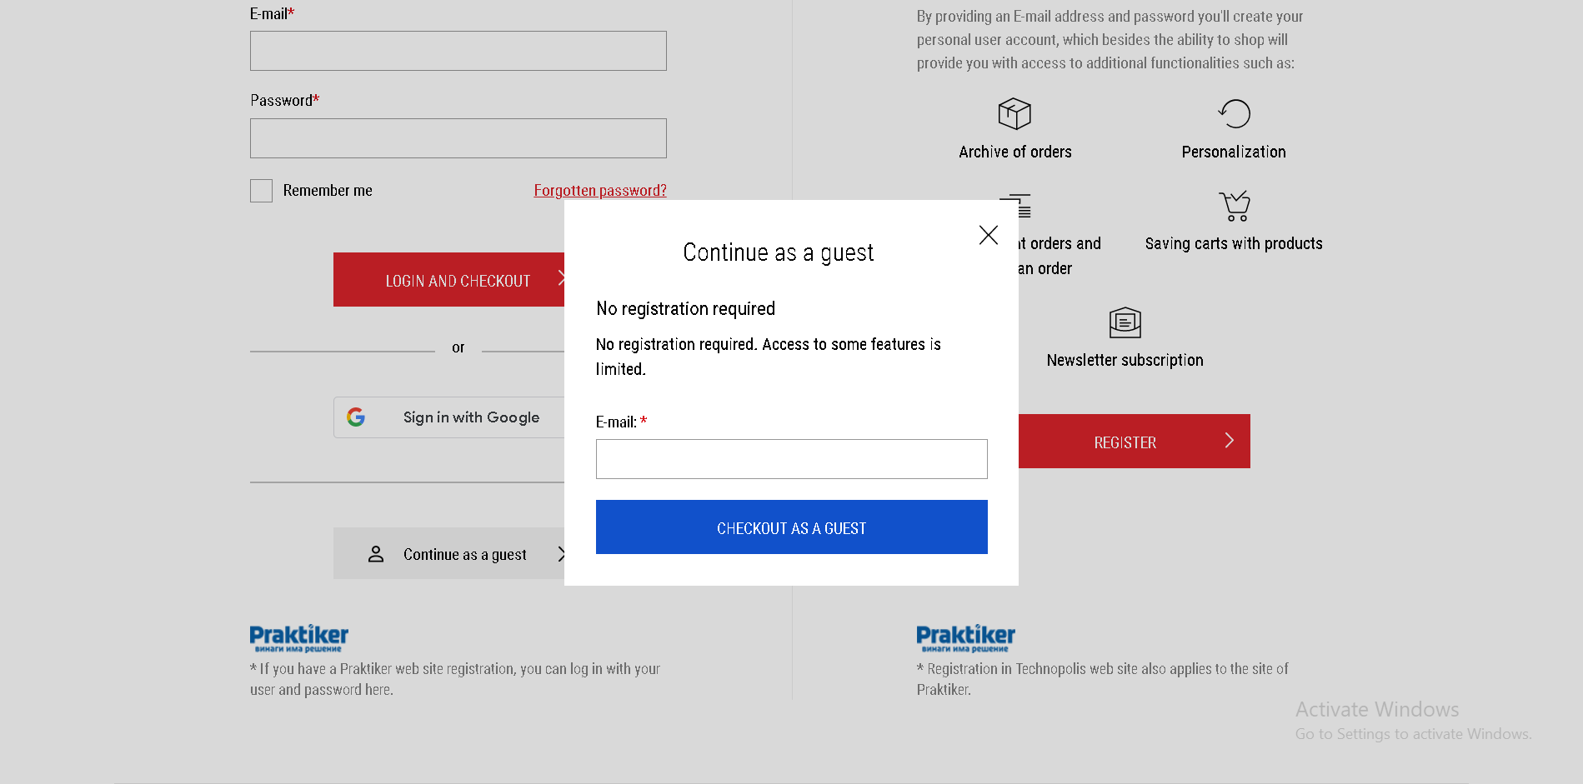
Checkout - Technopolis
You can also continue with no account. Just enter your email and continue with your checkout. Handy!

Slide 50
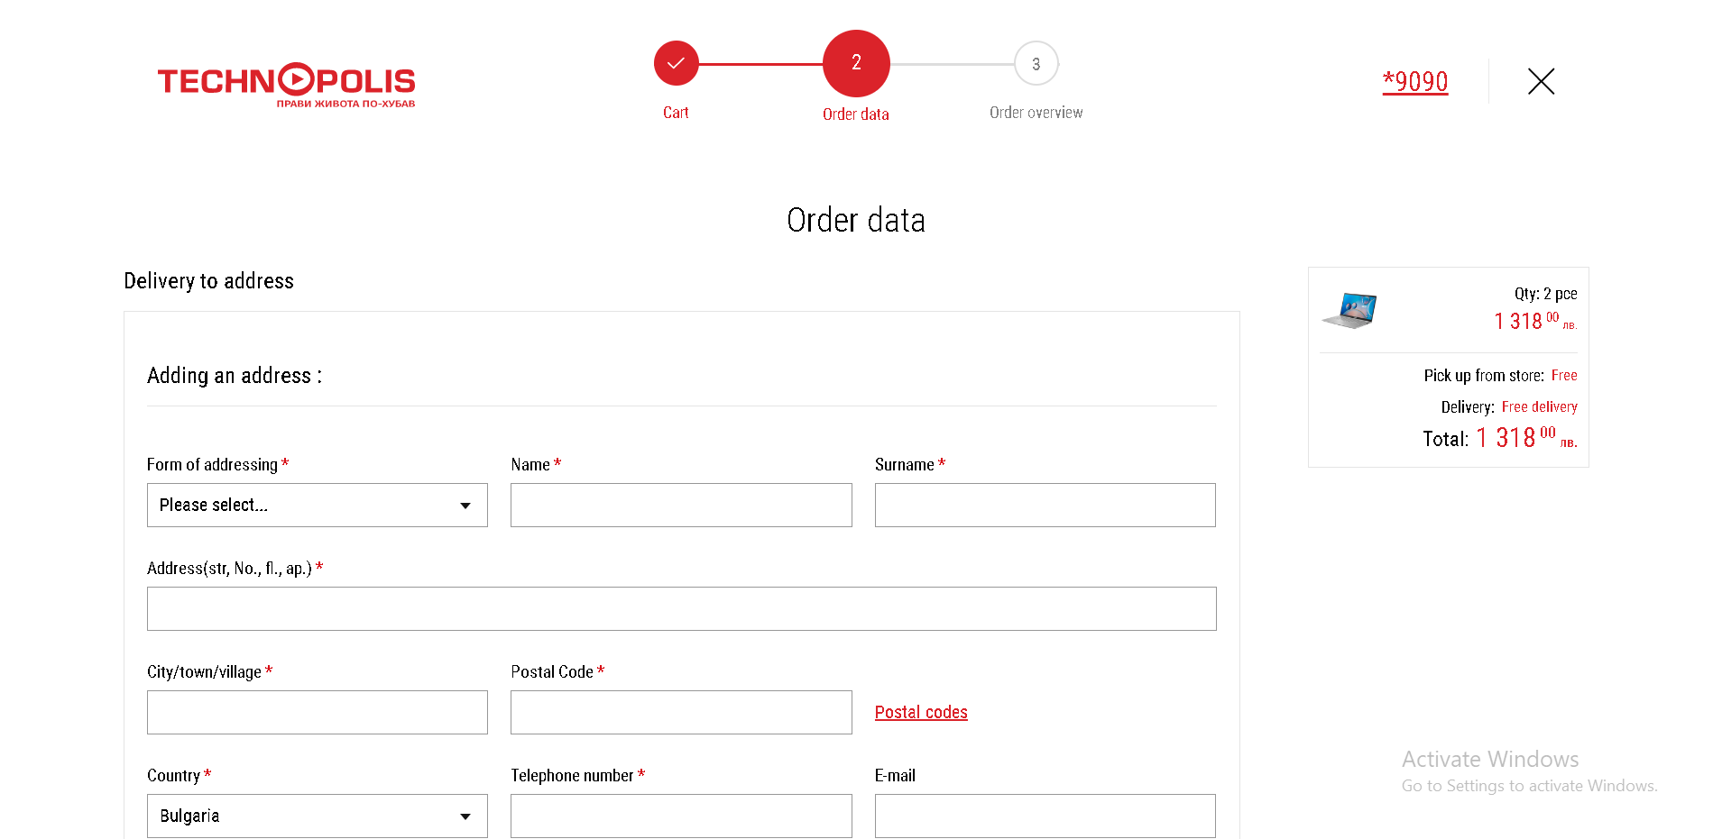
Checkout - Technopolis
When you continue after your cart, you’re prompted to enter your delivery address and you can see your total purchase on the right side

Slide 51
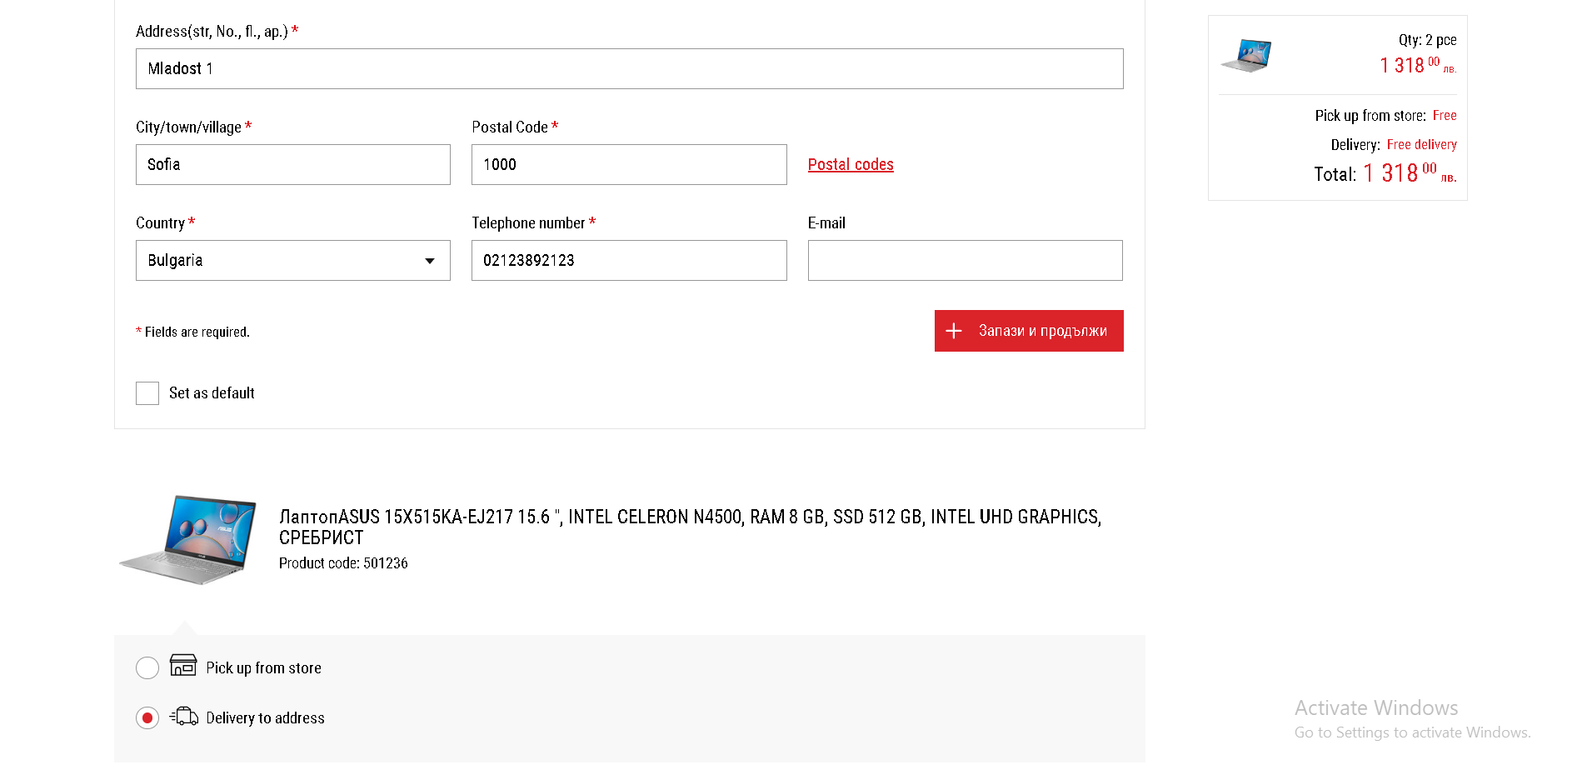
Checkout - Technopolis
At the bottom of the form there’s a “Save and continue” button (not translated) and a checkbox to save as default (for future purchases). Handy! You can also select if you want address or store delivery

Slide 52
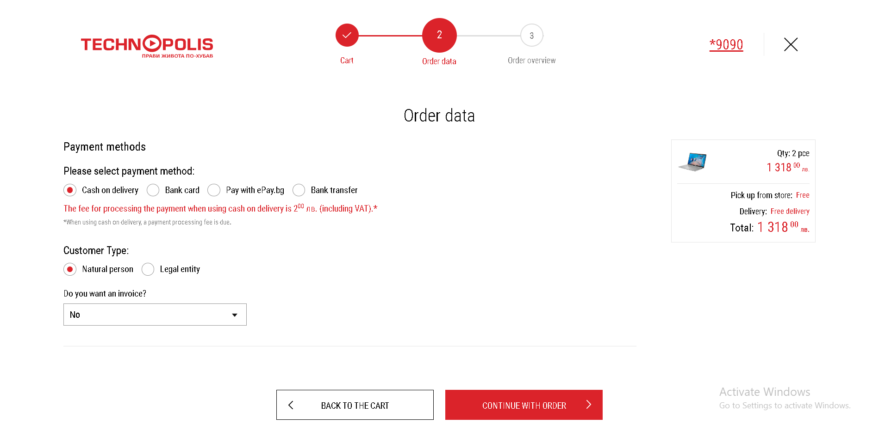
Checkout - Technopolis
On the next page you get your payment method as well as choosing if it’s a personal or corporate purchase

Slide 53
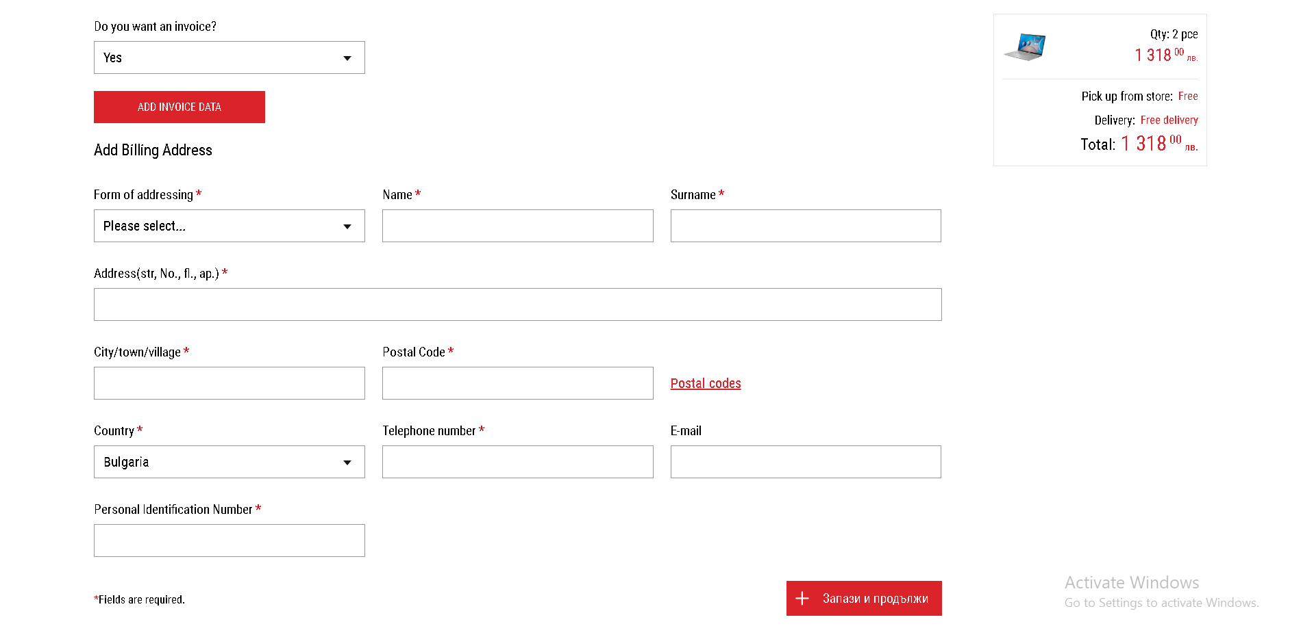
Checkout - Technopolis
And the option for an invoice

Slide 54

Checkout - Technopolis
Finally you get an overview of your purchase, with fees and delivery address

Slide 55

Checkout - Technopolis
You can also add a delivery note and read terms/information about your order

Slide 56

Checkout - Technomarket
After you proceed with the cart checkout, you get prompted with a login screen. Even though there’s only a login and register button, they didn’t fit it on one screen like Technopolis.

Slide 57

Checkout - Technomarket
After you login, you have an overview of your cart with warranties, way of delivery and change cart

Slide 58

Checkout - Technomarket
For the way of delivery you can either order it to an address or order to a Technomarket store for pickup

Slide 59

Checkout - Technomarket
For an address delivery you get a popup with all your personal and shipping information

Slide 60

Checkout - Technomarket
For a shop delivery you get a map that you navigate to a store on the map and select it to be delivered there

Slide 61

Checkout - Technomarket

Slide 62

Checkout - Technomarket
For the payment method, you have a few options, such as bank cart, on delivery cash, bank transfer and paying in instalments

Slide 63

Checkout - Technomarket
If you would like an invoice, you have to select if it’s for an individual or a business and fill out your details

Slide 64

Checkout - Technomarket
After you’ve placed your order, you have to pay for it to be delivered. You get an overview of the products you’ve bough and their quantity

Slide 65

Checkout - Technomarket
You also get to see the delivery address as well as contact information for the person receiving the order

Slide 66
Conclusion
Personally I prefer the UI and layout of Technopolis, but both sites have their pros and cons and I’ll go over them in the next slides

Slide 67

Technopolis - Pros
The color scheme of red and white along with the minimalist design really helps the site feel open, sleek and reliable
The compare function is really nice and easy to see side-by-side comparisons
You can order your items at a store or delivered to your address. You can also individually have some items delivered and others for a pickup
Has an English interface for people who can’t read Bulgarian (although there are a few spots that aren’t translated, but it’s not something important)
Everything works correctly without any bugs or errors
You can place orders without having an account

Slide 68

Technopolis - Cons
List view for products only expand the name and image, compared to Technomarket where you get informational rows about things like keyboard, resolution and number of CPU cores. They could have also added an image carousel so you can scroll through the other images for the item
Individual filters don’t appear on the top of the screen so it’s harder to remove just one filter easily without scrolling through them all. Also it would be nicer if the price range included a place to type in a number range instead of having to drag the range left and right
If you want to change the address of the store, you have to go to the home page or somewhere else where the header appears and click on the “My Store” button instead of selecting it in the checkout phase
It would be nicer to have more items for comparison

Slide 69

Technomarket - Pros
Gives you the option to remove individual filters in your search
List view gives you additional information about your product
There’s an interactive map where you can select the store for delivery
You have a little widget in the header that has your recently viewed pages
Variety of options for deferred payment options

Slide 70

Technomarket - Cons
The UI is extremely cluttered at points and you get no/very little information on the screen. Some pages are also layed out badly and confuse the user
The color scheme of gray/dark-gray/black really doesn’t work in some places making it very hard to read information
There are various small bugs and poorly styled elements that make the site feel cheap

Slide 71
Thank you for your attention ☺ !

